Slide 1

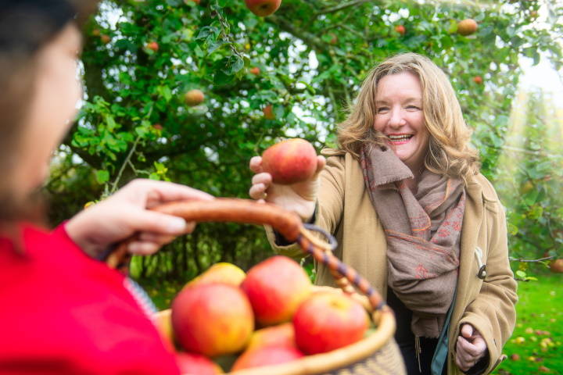
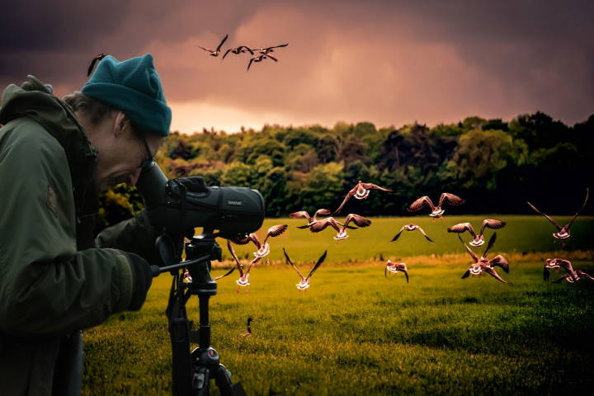
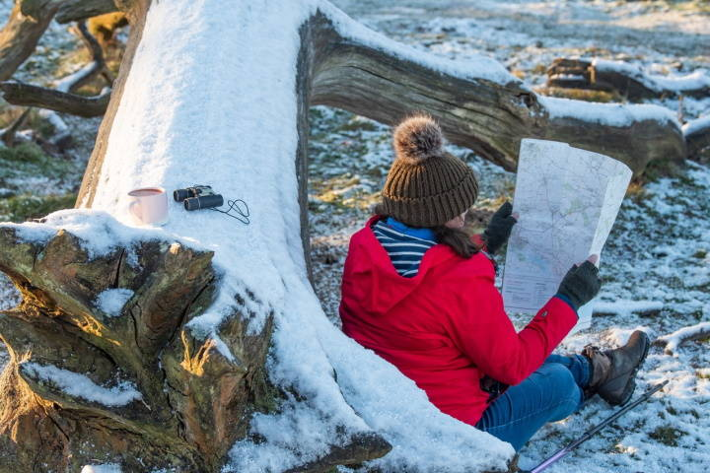
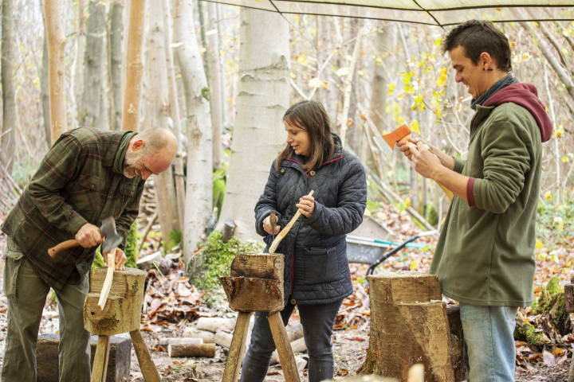
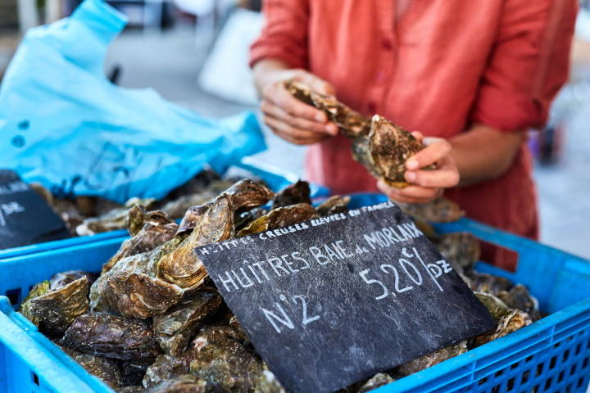
Designing and marketing low season tourism experiences
Prof. Xavier Font
University of Surrey
x.font@surrey.ac.uk

Slide 2
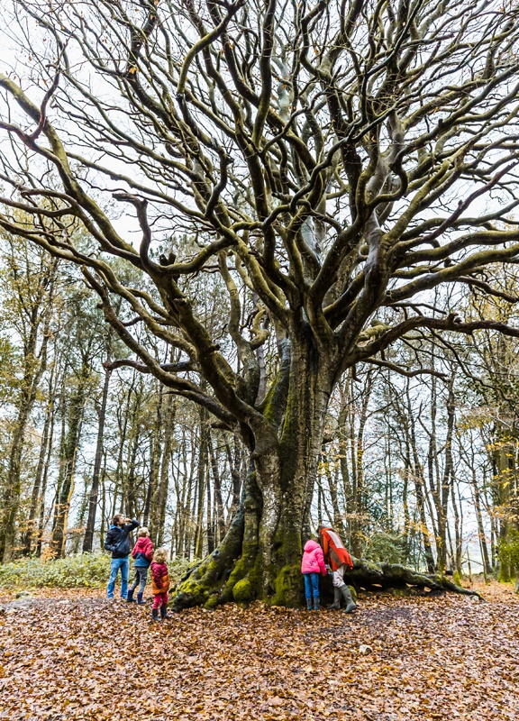
Programme
Six key messages
Products, make way for experiences
Different seasons, different markets
There’s something special about your place in the low season
Let’s design innovative experiences
Time for marketing and storytelling
Be clear what benefits you expect
Notes:
©L’oeil de Paco

Slide 3
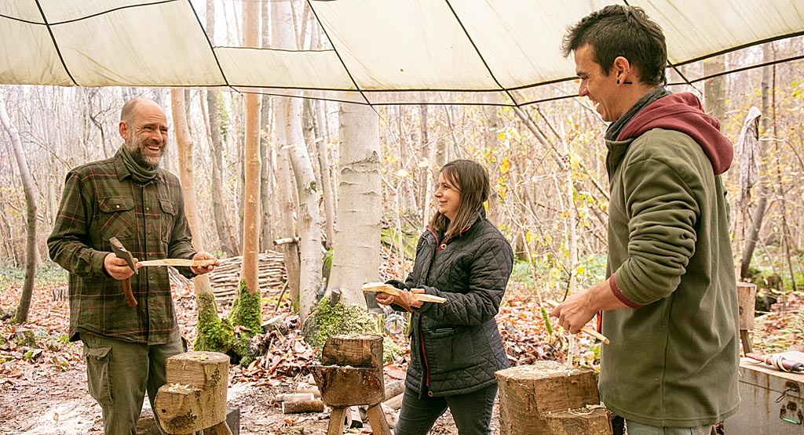
1. Products, make way for experiences
Notes:
©Kent Downs AONB and North Downs Way National Trail

Slide 4
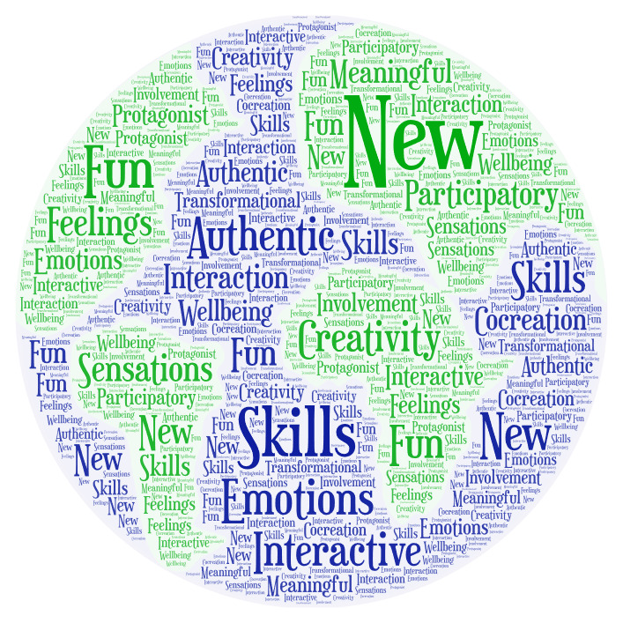
What is a sustainable tourism experience?
It is active, participatory, authentic, and respectful
An experience is a product or a service that triggers pleasure, or positive emotions or senses, enables the acquisition of new manual or intellectual skills and/or fosters beneficial interactions with others.
A sustainable experience is a genuine and special event that is anchored in daily life, highly exciting and participative. It is an experience that respects host communities and their cultural and natural heritage. A sustainable experience targets, first and foremost, people’s wellbeing and then it benefits the environment where it takes place.

Slide 5
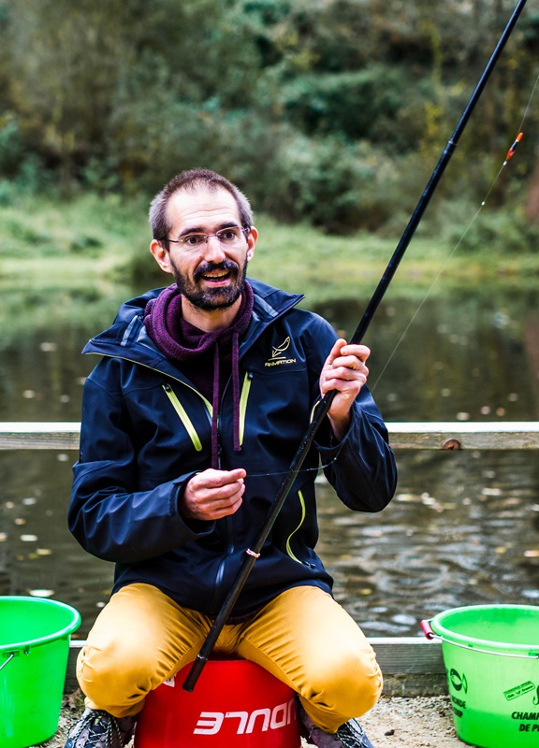
Engage your customer’s five senses
Experiences are multi-sensory
Aesthetics, colour and light are the primary contributors to experience perception
Experiences can be enhanced by music, and other natural or artificial sounds
Textures improve a traveller’s participation with their surroundings
Odours and tastes enhance visitor engagement
Inclusivity and accessibility
Notes:
©L’oeil de Paco

Slide 6
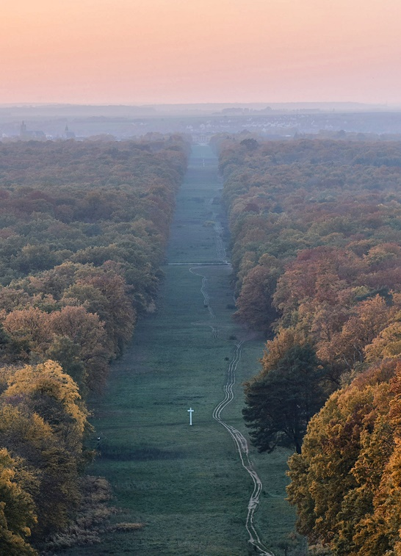
Engage your customer’s five senses
We use our local and seasonal assets as motivation for a visit during the low season
Laurence Francart is Director of the Compiègne Tourist Office (FR)
Setting up a wild-plant themed tour with a sylvotherapist guide within the Compiègne forest highlighting the unique discoveries that can be made in our local natural environment during the low season.
“Forest bathing with friends“, "botanical treasure hunting with the family“, "discovering the culinary flavours of wild plants“, deeper connection with nature thanks to a guidebook with plant cards.
Few holidaymakers want to feel like they are going to school on a tour, but most are looking for memorable experiences while learning interesting, and sometimes even practical, tips.
Notes:
© ARC

Slide 7
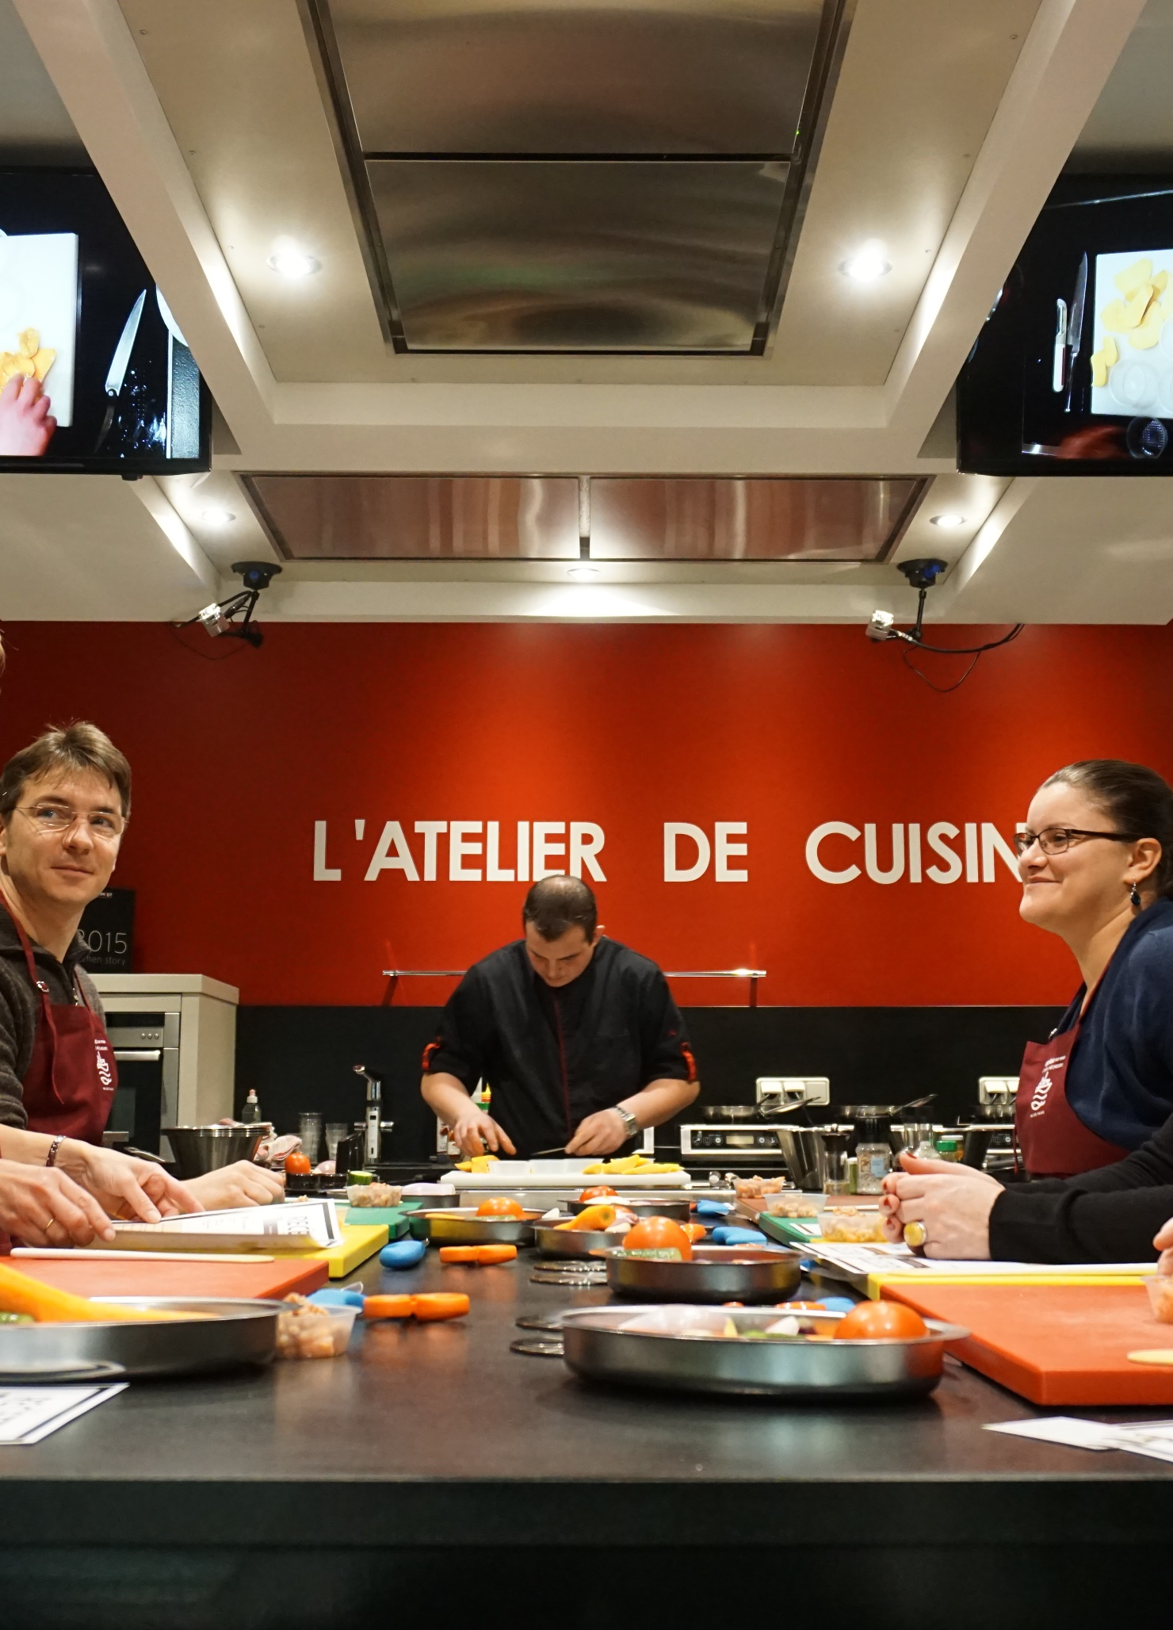
Experiences are co-created
People are at the centre of experiences
Hospitality and tourism businesses: front-office workers such as receptionists, guides and waiters are those who engage the most with travellers.
Other businesses: stakeholders (such as artisans, crafters, artists, farmers, local shops and foresters) have an important role to play through their interactions with travellers.
Locals: travellers may want to experience an off-the-beaten track existence and live like a local via Airbnb experiences or Greeters networks.
Travellers: travellers exchange information and tips before, during and after their trips.
Notes:
©Pas-de-Calais Tourisme

Slide 8
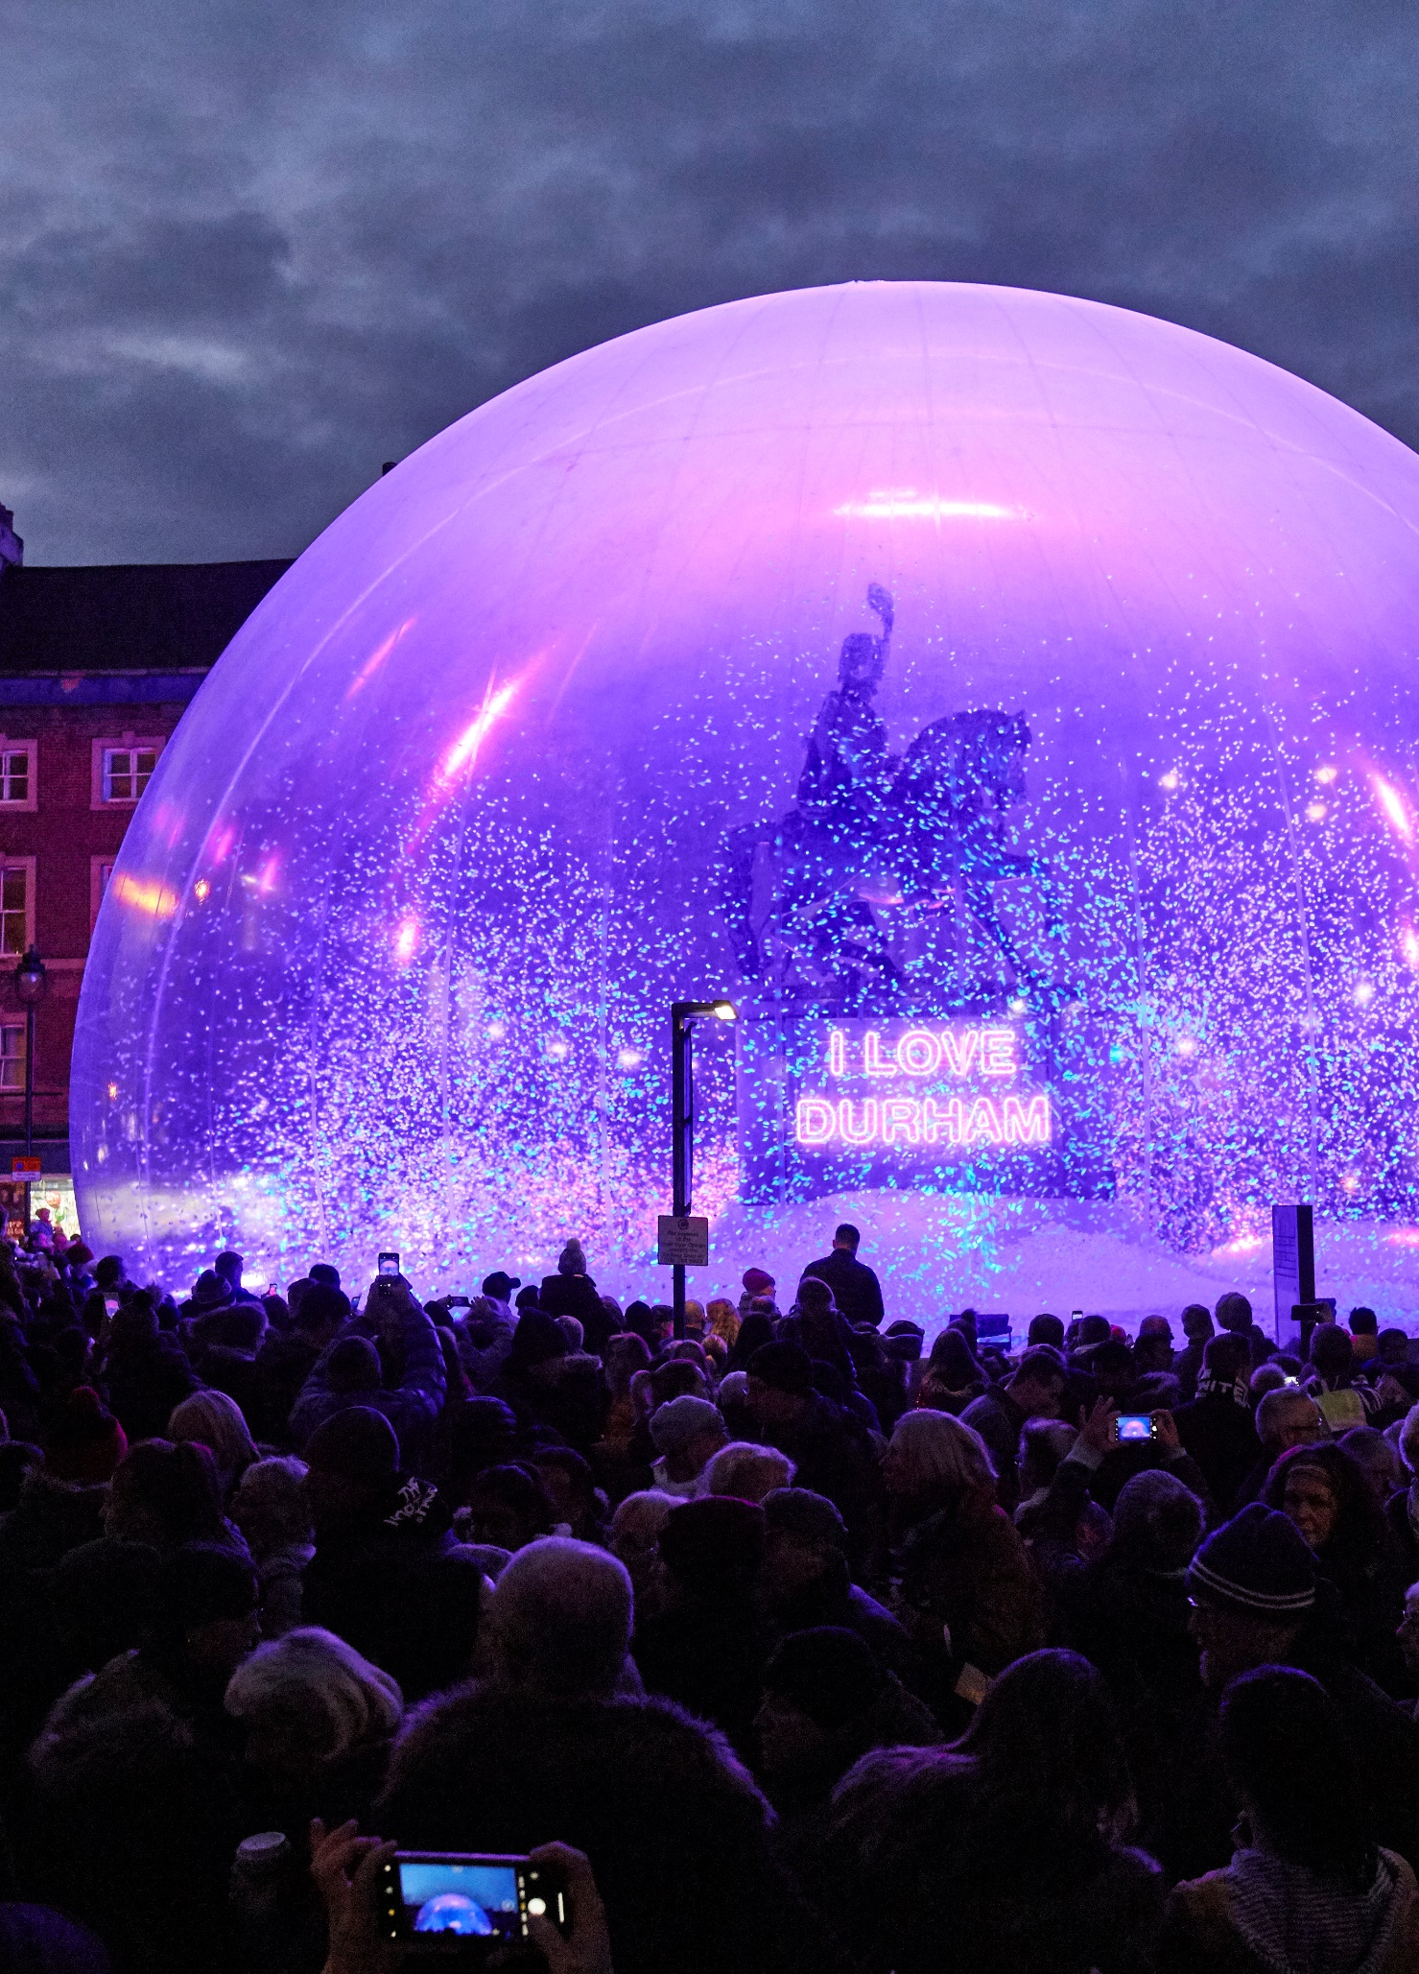
Experiences are co-created
We bring placemaking benefits, address seasonality and create a sense of pride and belonging
Melanie Sensicle is the former CEO of VisitDurham, and one of the promoters of Lumiere Durham (UK)
Lumiere aims to showcase the city to an international audience and change the way we experience our urban surroundings. It has attracted more than one million visitors to Durham, and in 2019 generated an economic impact of over £8m.
Public-private partnership. Balance between world-class artists and emerging local and national artists. Interactive feature that lets users create their own artwork to share via their social network
Develop low season activities with strong community involvement to ensure a deep significance for local stakeholders, who can engage more in low seasons than they would be able to in busy summer periods.
Notes:
©Durham Lumiere

Slide 9
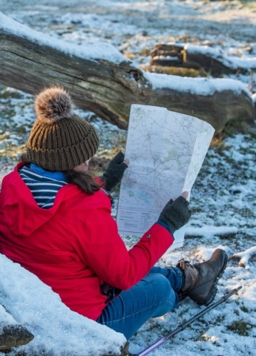
Why low season experiences?
Because healthy year-round business helps you and your destination thrive
Approximate seasonality for rural tourism businesses is 10-15% of demand in January to March, 25-30% April to June, 30-50% July to September and 15-20% October to December.
Seasonality occurs for three very valid and real reasons:
natural factors (weather dependency, climate, location and access)
demand factors (holiday patterns, availability of leisure time, social norms)
supply factors (available activities, trading patterns)
Low season experiences cannot be exact replicas of summer experiences only sold to people who accept worse weather.
Need to find something unique about your low season that will help you design experiences that are particularly attractive.
Notes:
©Norfolk County Council

Slide 10
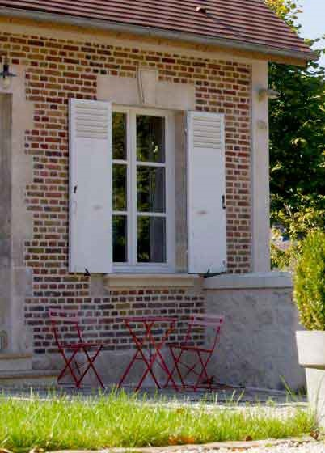
Why low season experiences?
We put people at the heart of our experience
Cécile Davidovics is the Owner of the B&B Le Clos des Tilleuls (FR)
We have developed communal living spaces that encourage human interaction, regardless of the weather, and that promote family activities available in the low season.
The chance to share good times indoors: board games, equipment for children, a play area on the mezzanine, baking workshops for young and old, animals feeding
It is essential to identify your unique selling proposition, and direct your efforts toward building a relevant and complete offer for a key target market.
Notes:
© Oise Tourisme Anne-Sophie Flament

Slide 11
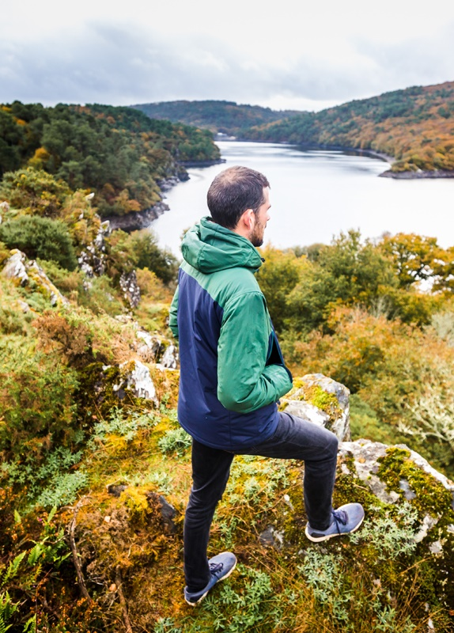
Be proactive in managing your seasonality challenges
Treat seasonality as a business risk
Avoid – Change plans to circumvent the problem, such as identifying new markets that you can serve that either complement your current markets or that are not seasonal.
Control / mitigate / modify / reduce – Reduce the likelihood of winter conditions to negatively impact your business. Identify ways to upgrade your offering by addressing some of the shortcomings in low season, such as weatherproofing your current services and investing in infrastructure.
Accept – Assume that your experiences will have limited demand due to uncontrollable events; reduce prices to attract demand; reduce operating costs to reduce losses; and budget the remaining cost via a contingency budget line.
Transfer / share – Outsource a portion of the risk to a third party (or parties). For example, outsource an activity, such as running an event, to an expert company.
Notes:
©L’oeil de Paco

Slide 12
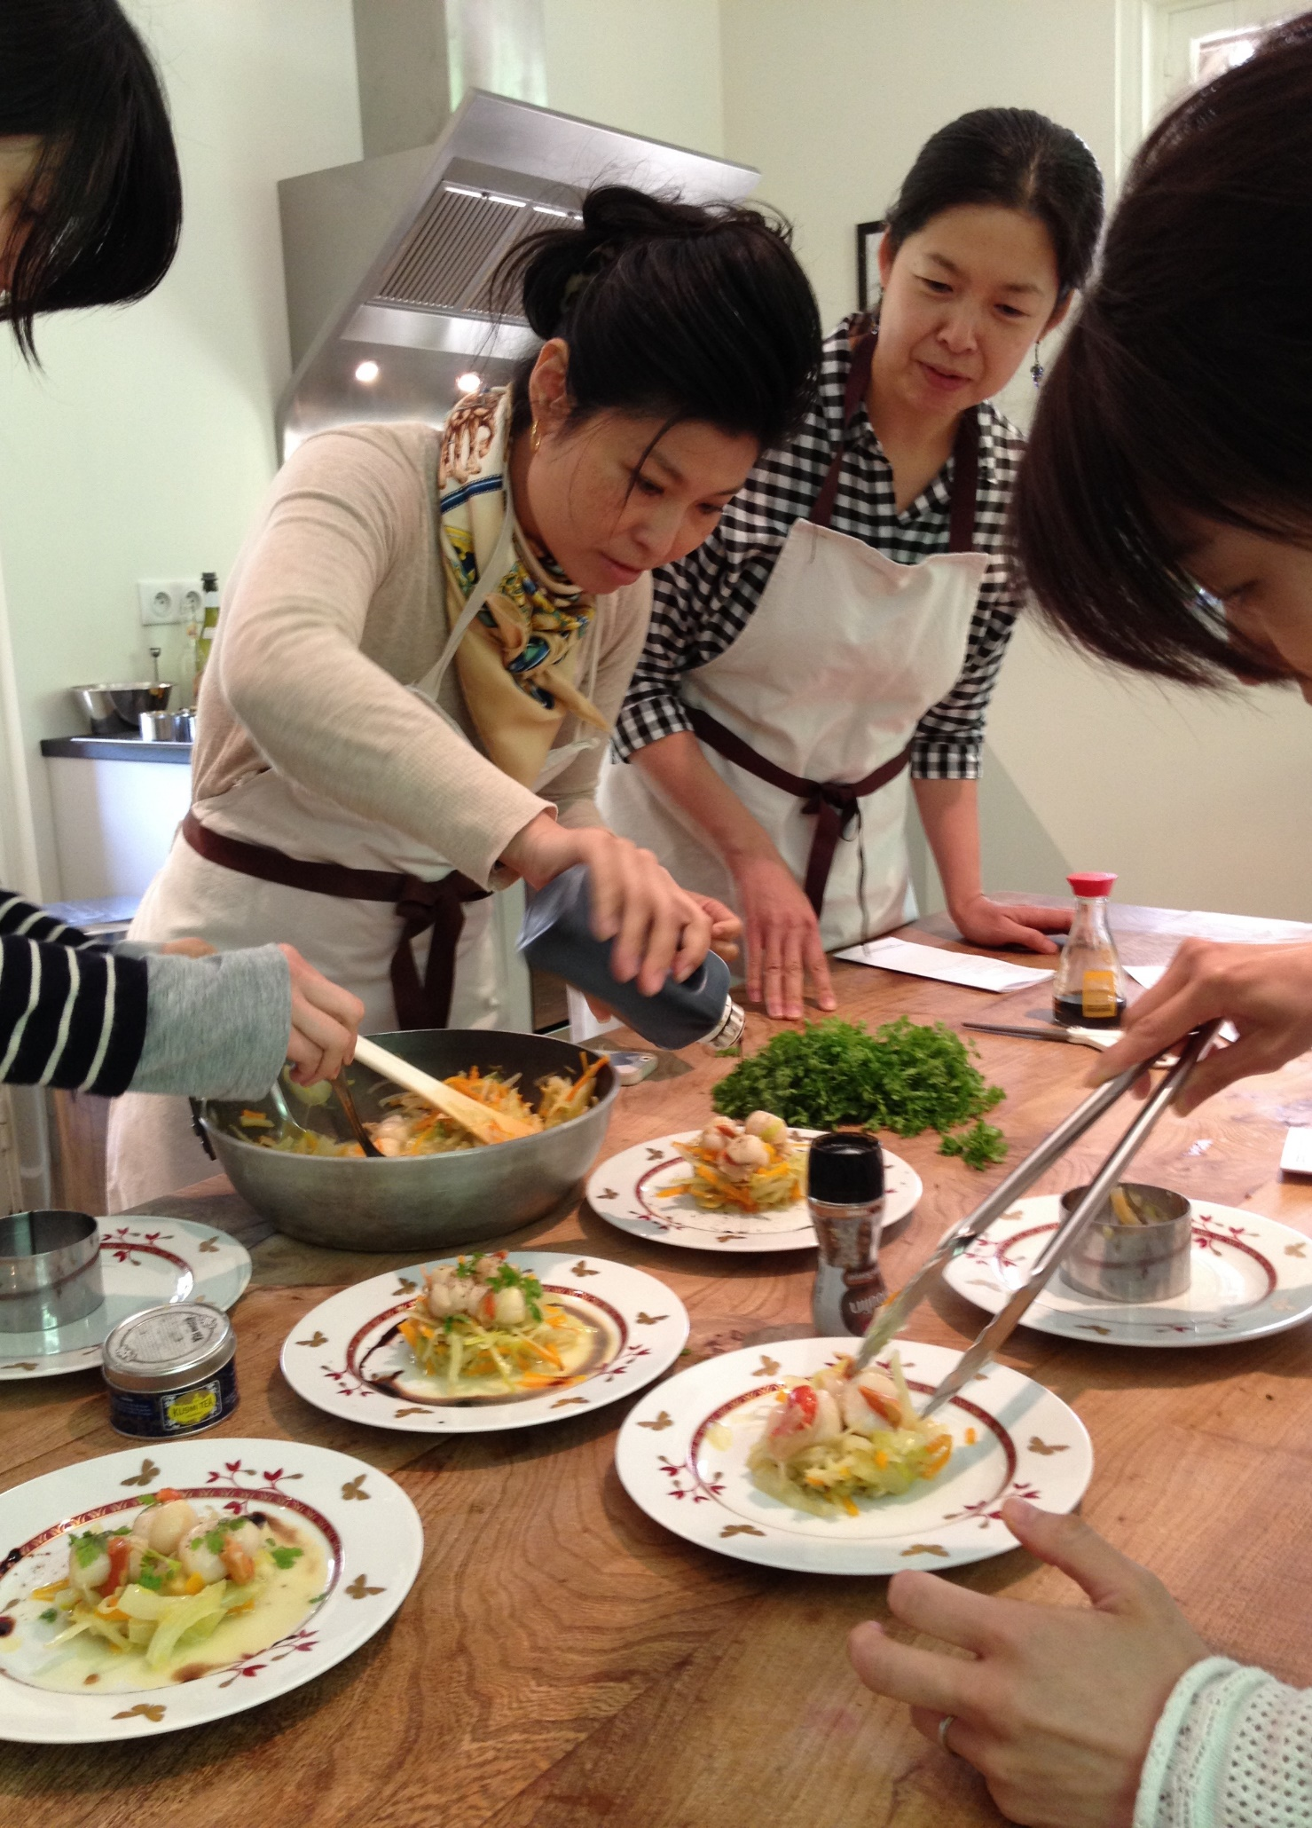
Be proactive in managing your seasonality challenges
We communicate year-round dynamism to boost low season occupancy
Alix De Lauzanne is the owner of the guest house Villa du Chatelet (FR)
The Villa du Chatelet was built for the internationally renowned composer Léo Delibes. Our wish today is to make this house live as fully as it did at the time of its famous patron.
Welcoming artists from all over the world during the low season to ensure that the musical and artistic heritage of the villa is kept alive. Leading cooking workshops and special events for residents and visitors. Hosting seminars and team-building offers.
Activities such as artistic performances, and even sometimes our table d'hôte, are not intended to be financially profitable as a stand-alone activity, but they do contribute significantly to the quality image of our accommodation, which in turn increases our occupancy rate all year round.
Notes:
©Villa du Chatelet

Slide 13
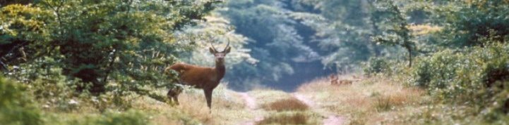
Task 1: What do you want to achieve?
Prioritise and develop plans to achieve your objectives
Generate first time sales. Which markets are available, or more easily identifiable, for low season and what type of incentive do you need to attract those markets?
Increase customer loyalty and repeat sales. What do you need to do to tempt past customers back? Do you need to remind them of a favourite experience, provide a new experience or offer a discount?
Increase the volume of the same service purchased. Your target may be to get customers to stay longer or to buy three souvenirs instead of two.
Increase the number of services purchased together. Bundling different services allows you to tailor-make experiences and to upsell. It also makes planning the experience easier for your customer. Who can you partner with to cross-sell?
Increase the size of the group. Your strategy may be to get loyal customers to return, but with family and friends. What incentives can you provide your loyal customers to do so?
Notes:
© ARC

Slide 14
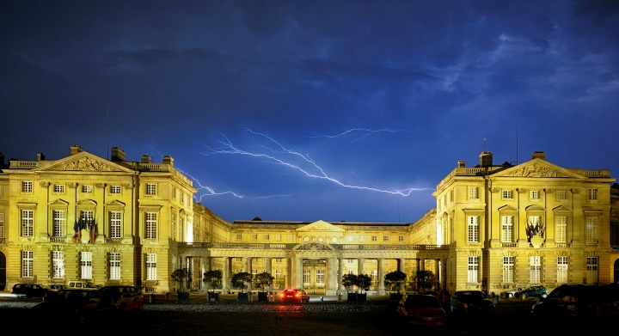
2. Different seasons, different markets
Notes:
© ARC

Slide 15
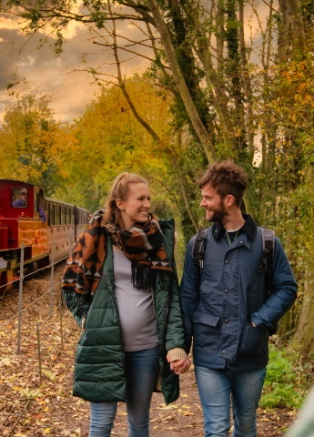
Why do we treat the customers the same?
High and low season customers are different.
Low season travellers seek leisure and travel experiences for different purposes; they seek different benefits, search suppliers differently and will be satisfied with different types and levels of service.
Invest time in learning about different markets. Understand how to be more inclusive of different groups of customers
Use the new knowledge you gain to adapt your offer to different types of customer and to balance changes in demand.
Notes:
©Norfolk County Council

Slide 16
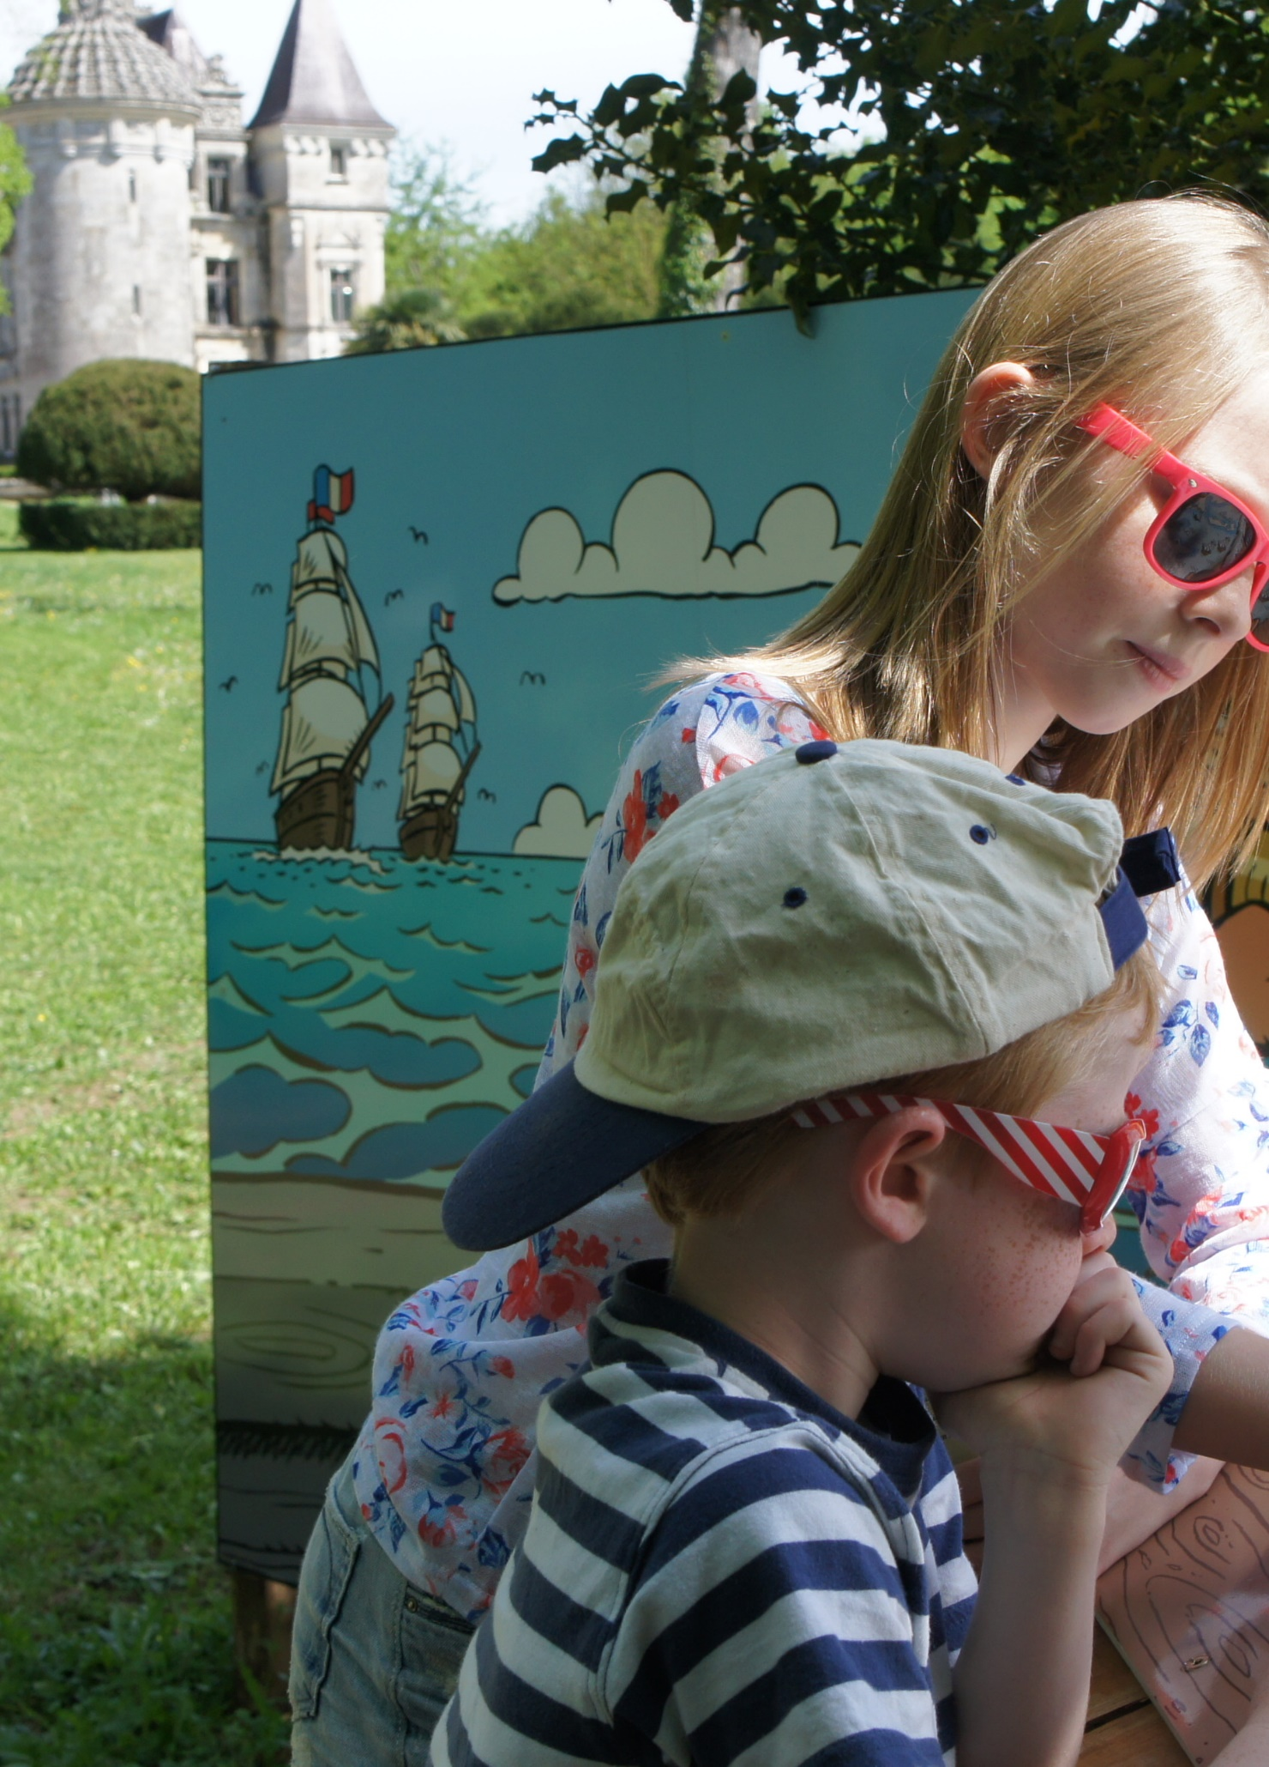
Why do we treat the customers the same?
We progressively diversify our product and markets
Alexandre Tisné-Versailles is the Marketing and Development Director at the pirate-themed, historic monument of Le Château des Enigmes (FR)
Starting from a single product (a themed treasure hunt in a castle), we developed our offer with complementary products (unusual accommodation and an escape game) to generate activity all year round by targeting different audiences.
Creation of treehouses within the the 9 hectares of parkland belonging to the château to reach young professionals in their 30s as well as the 50-60 year old population. Development of escape games as family and team-building activities.
Use your resources to consider product and market diversification from a complementary perspective: use your expertise, understand your target market and ensure that new products can complement each other, not compete.
Notes:
©Le Château des Enigmes

Slide 17
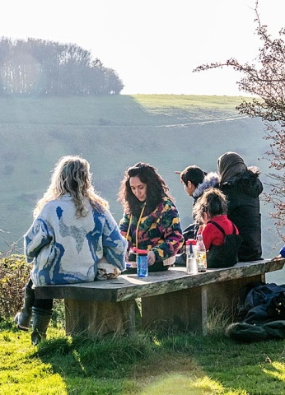
Locals first
Your key to winter survival is to have a healthy, regular local clientele
First time customers are more predictable, but also harder to influence. They can be highly price sensitive but also use price as a sign of quality because they cannot judge quality in advance as they have no prior experience. You are likely to pay a commission to attract them.
Selling to local market is quite the opposite: Local customers will recognise quality as they can distinguish between fake and real products. They are more likely to seek variety. Devote your marketing budget to your social media activity.
Word of mouth is crucial. Show your local markets how you have multiple offerings, to show that they can do something different when they come back
Notes:
© Kent Downs AONB and North Downs Way National Trail

Slide 18
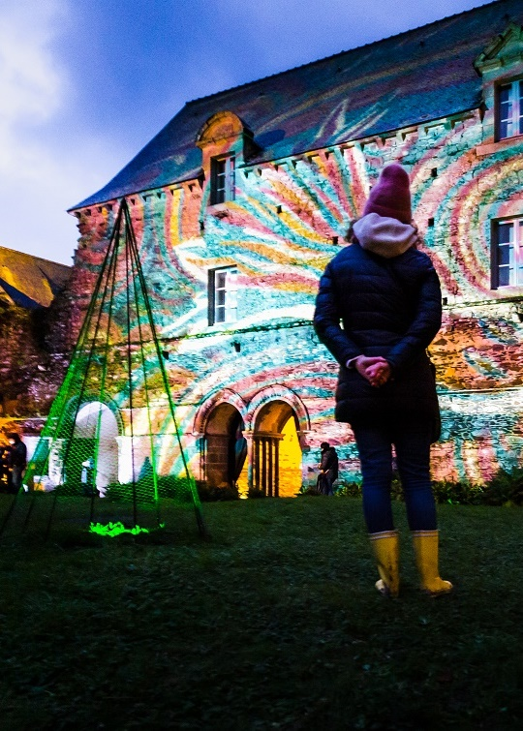
Locals first
We change our market priorities in the low season from tourists to locals
Françoise Le Moine is the Director of the Beauport Abbey (FR)
During the low season, we move from a "tourist" event calendar to a cultural programme for our local communities, as well as making our premises available for community workshops.
Reorganising the space that is usually set up for large concerts, to instead have smaller reflective workshop areas. Supporting projects for the transmission of traditional, local know-how, such as the rehabilitation of a wicker grove from the planting of willows to the pruning of wicker and the art of basketry.
It is essential to convince local authorities to reorient political discourse and funding logics away from the promotion of the territory's assets in high season towards an awareness of the value and public utility of a heritage assimilated and carried by its residents.
Notes:
© L’Oeil de Paco

Slide 19
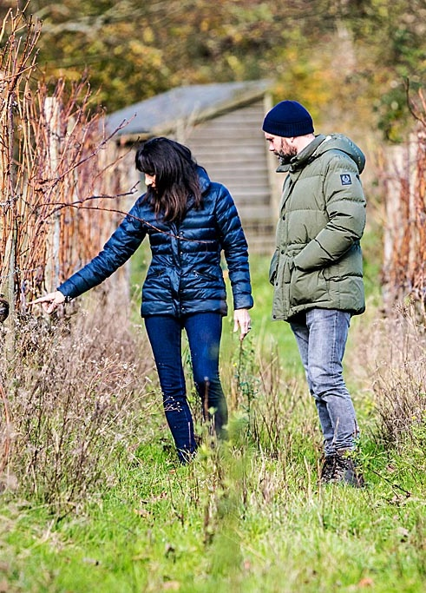
Encourage repeat visits
Low season is the time for loyalty
Tell customers what to look forward to. On their way out of your venue, tell customers what’s on next week (or next month).
Create an annual pass. You can further learn from the techniques used in leisure centres to manage demand: create an autumn to spring membership, a midweek membership, or a 9 to 3pm membership.
Create a sense of belonging. Create a club of regular users; give them status and reward their loyalty with new offers.
Run clubs. Work with specific community groups to increase occupancy of your premises.
Discount or upsell. Provide discount vouchers for next purchases that are time-limited. Provide upgrades for visits Monday to Thursday to encourage higher expenditure.
Provide loyalty gifts. Loyal customers or annual members could be given a birthday gift, in the form of one free pass to bring a friend
Notes:
©Kent Downs AONB and North Downs Way National Trail

Slide 20
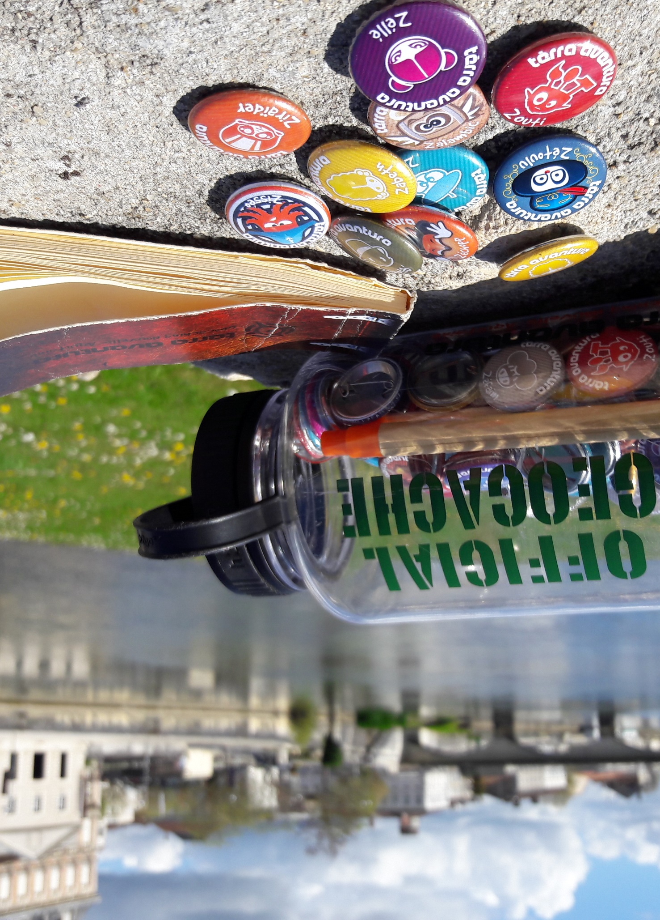
Encourage repeat visits
We create a sense of community by gamifying the discovery of local heritage
Laurence Pourageaud is the Quality and Geocaching Coordinator at Charentes Tourisme (FR)
We co-developed a region-wide treasure hunt that invites users to venture into the most unexpected corners of the destination through a geocaching mobile application.
Life-size treasure hunt, for young and old, enhanced with fictional and endearing characters. Strong user community with players setting ambitious targets comparing and sharing badges online and offline, nourishing its own marketing buzz
It is important to offer only free tours, with no commercial commitments, the clues should always remain in the public domain. Tool to encourage visits to sites or museums, half of users spend at least one night away from home on each tour.
Notes:
©Charentes Tourisme

Slide 21
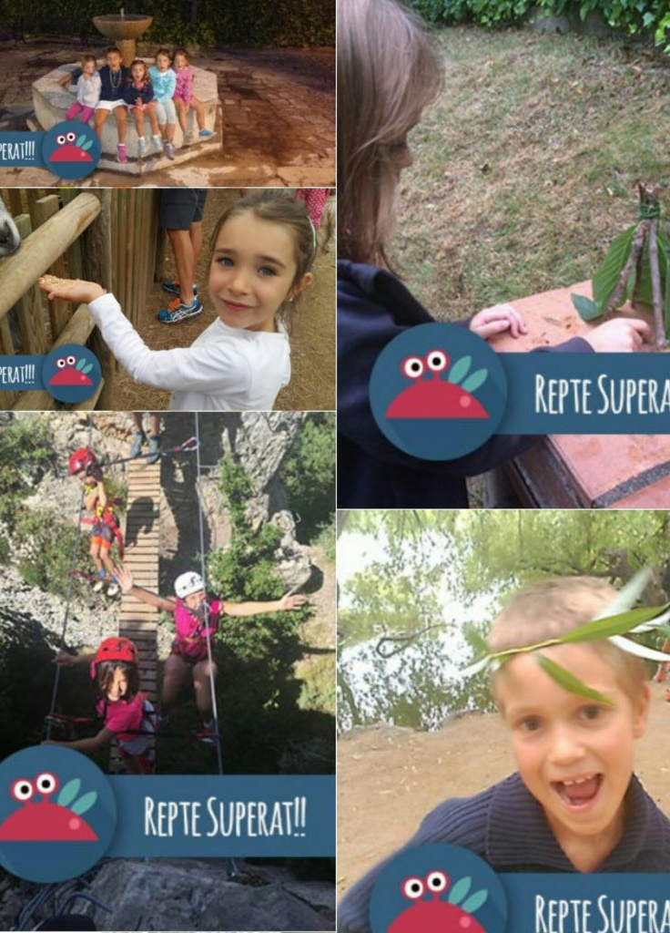
Encourage repeat visits
We offer a bundle of activities to promote low season travel
David Isern i Casanovas is the General Manager of Cerdanya Resort (Spain)
Based on the concept of the UK National Trust’s “50 things to do before you are 11¾” challenge, we offer a bundle of 50 nature challenges for families to do together and have fun in nature. This family activity aims to increase loyalty, satisfaction, word of mouth, and reduce seasonality.
All the activities can be done locally to the resort and completed as a family without requiring staff involvement. Family passport. Prizes for challenges. Challenges designed to be best achieved in the spring (flowers identification) and autumn (angel in autumn leaves).
Identify experiences that have emotional and entertainment value to your customers but that cost little for you to offer, and design them to promote visits during low season.
Notes:
©Cerdanya Resort

Slide 22
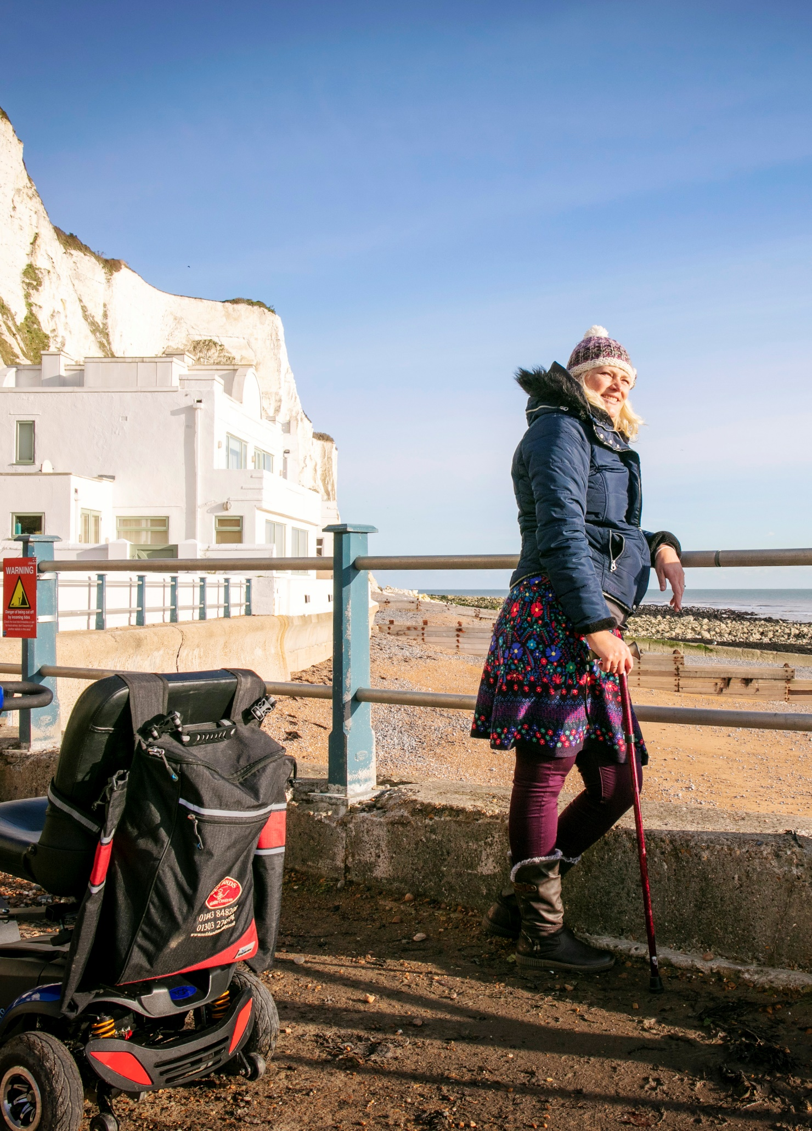
Aim for equality, diversity, and inclusion
The world is a mosaic: design experiences for every market
Is your business implicitly biased by targeting white, Christian, middle class, heterosexual couples with two children, who will drive and have no disabilities? You may feel uncomfortable with this question and yet the photography you use in your website speaks volumes.
Targeting a diverse community is not only the right thing to do, it also gives you excellent business opportunities.
There exists a range of disabilities and most of them are not visible
Companies that demonstrate disability confidence achieve over 25% higher revenue
Notes:
©Kent Downs AONB and North Downs Way National Trail

Slide 23
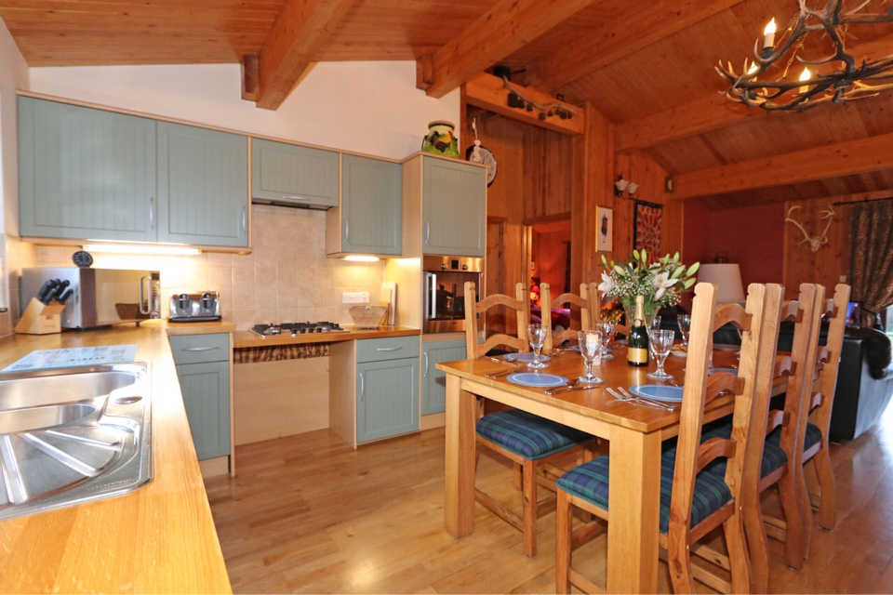
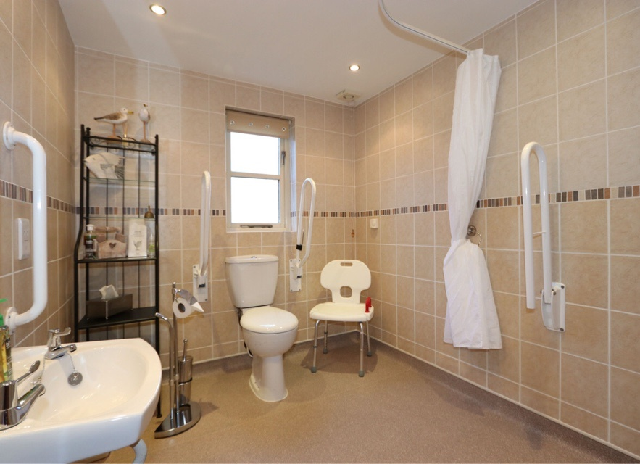
Aim for equality, diversity, and inclusion
We design our facilities to offer inclusive experiences
Sonja Gregory is the co-owner of The Hytte, an accessible self-catering cottage in Northumberland (UK)
Our cottage offers the highest level of accessible enjoyment and entertainment. Our occupancy rate is over 80%, compared to a regional average of 55% annual occupancy.
Whole group participation. Kitchen units designed to accommodate wheelchairs. Sympathetic handrails. Accessible bathrooms. Accessible outdoor sauna and jacuzzi. Extra charge for energy and donation to charities.
Create a sense of “togetherness” for people with and without disabilities. Design experience so that customers feel they can all partake in an effortless way and irrespective of the time of year.
Notes:
©Sonja Gregory

Slide 24
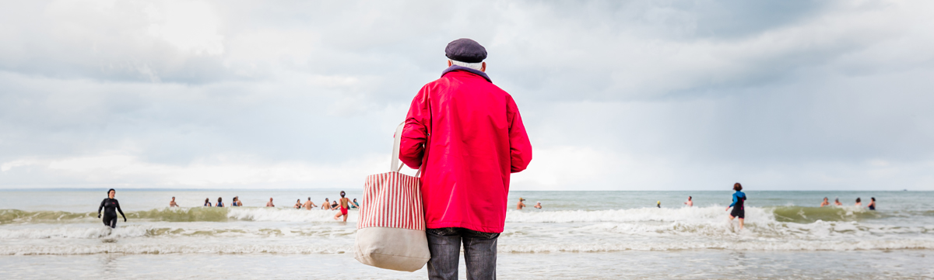
Task 2: Identify complementary markets
Diversify your markets and learn how to respond to their different needs
Low season visitors tend to be more local, stay for a shorter period of time and book late (or just turn up). Likely to be repeat visitors and seek variety.
Working with different markets reduces your risk of dependency on a single market, which makes your business more resilient.
Prepare a day calendar. Write down which type of customers you expect at each hour and what percentage of your maximum available capacity they represent. Do the same for different days of the week. Do the same for November to March
Colour code the different segments (in your day, week or months) according to the capacity figures: red for under 50%, amber for 50-75% and green for above 75%.
Make a list of the types of customers you get currently and group them in two columns: Group A are those that can change the time and day when they come and Group B are those that cannot.
For Group A: return to our list of tactics to encourage them to return and think how you can use these tactics to change the times at which your customers visit you, away from green (above 75% occupancy) times, towards amber and red times.
For Group B: identify actions you can do to increase the number of people at that same time.
Brainstorm who might be in a Group C: potential customers that are currently not patronising your business.
Notes:
© L’Oeil de Paco

Slide 25
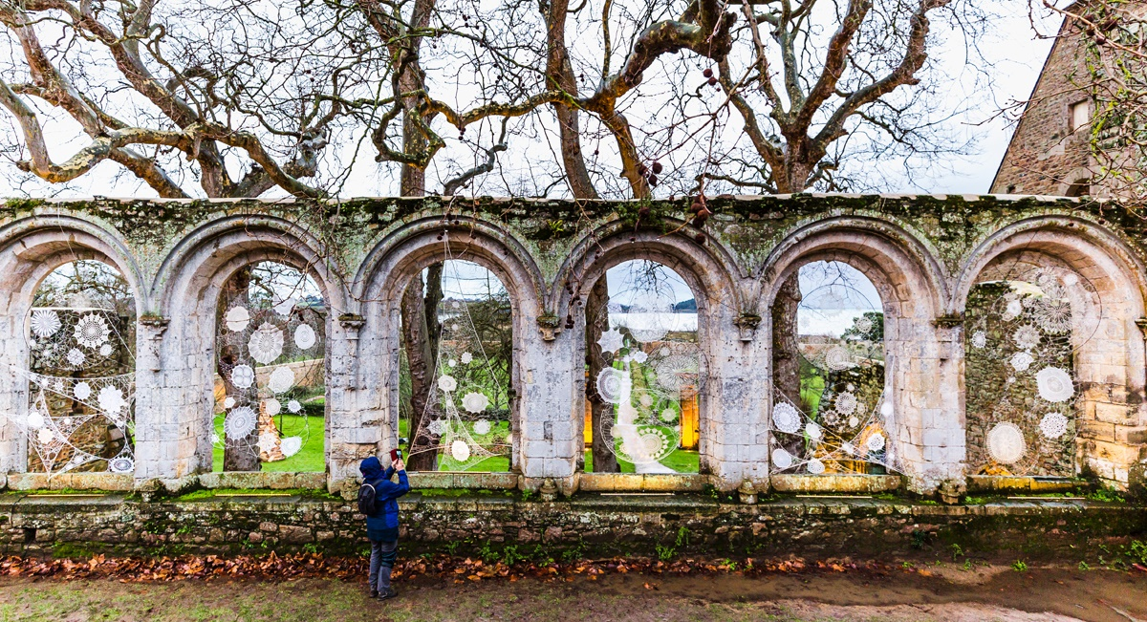
3. There’s something special about your place in the low season
Notes:
© L’Oeil de Paco

Slide 26
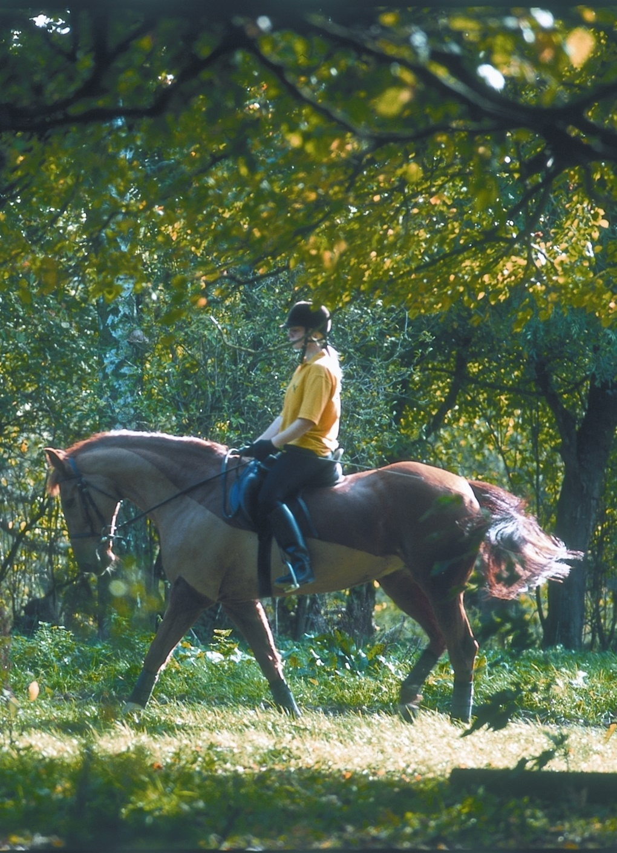
What are your seasonal assets?
Think about what you like to do in your area from November to March
Natural environment. Use the uniqueness of each season. Colours, smells and sounds: The sound of the wind in the branches, the moving trees mirrored on the water, the smell of wet earth… Specific migratory birds or animals, or flowers that cannot be found in summer.
Emotions. Show the link to your customers: braving the rain or the tumultuous sea becomes an adventure, the outdoor coolness reinforces the sensation of cosiness and serenity when cuddled up by the fireplace with a hot mug of tea.
Access. Offer places usually off-limit during crowded summer seasons. Go behind the scenes of nature conservation with park rangers, visit the restoration area of a museum, walk your dog on the beach.
Time is different. What can you offer that your visitors can enjoy most when not limited by time? Ex: Access to a great second hand bookshop, a local café with comfy sofas and excellent coffee, or activities such as cooking lunch with a chef
Specific events. What local events take place in your area? Is there a patron saint associated with a local craft celebrated during those months? A carnival? A food or art festival? But also, are there specific natural phenomenon taking place then?
Notes:
©D Evans

Slide 27
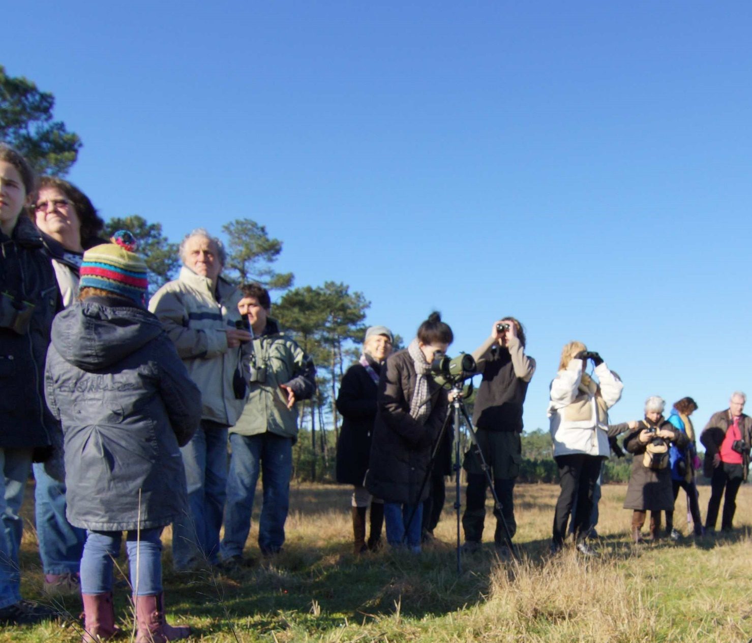
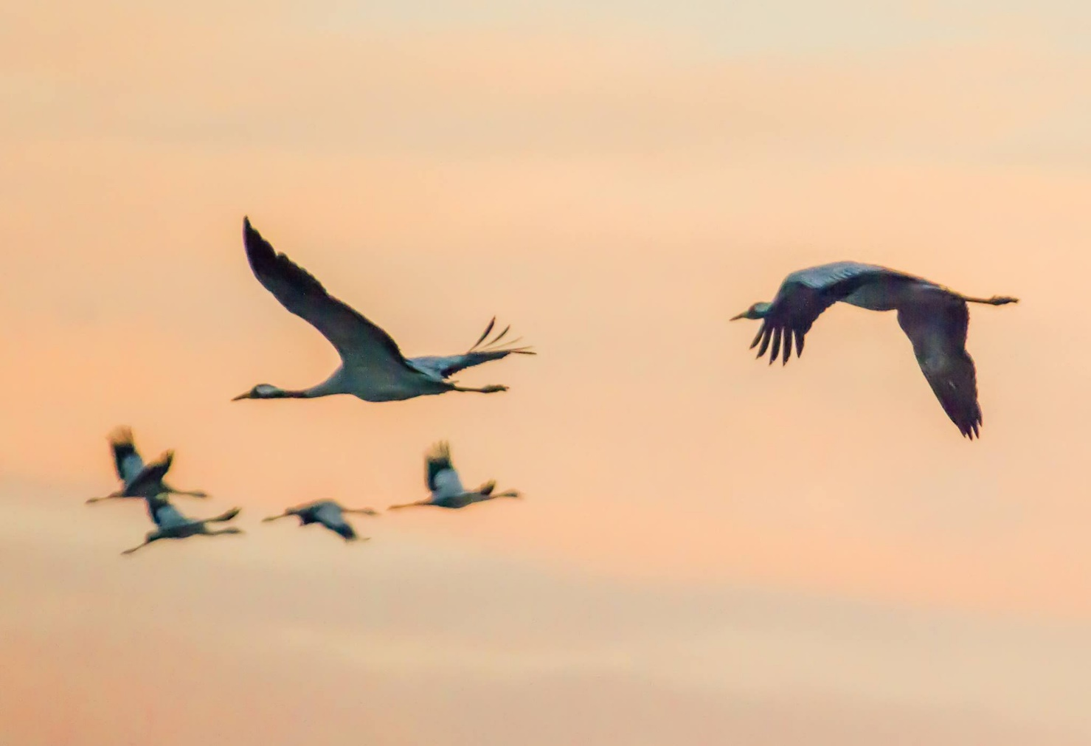
What are your seasonal assets?
We help local stakeholders to develop their skills in a high value-added product in low season
Béatrice Rénaud, Head of the Tourism and Brand Unit, Landes de Gascognes Regional Nature Park (FR)
Capitalise on the wintering of Grey Cranes from November to mid-February to offer a unique experience.
Develop knowledge of this phenomenon among local tourism actors (accommodation and restaurant owners, tourist offices, nature reserves, guides, etc.). Create a charter with nature associations. Work together to preserve the reception conditions of the migratory birds and to promote the birdwatching experience. A premium experience increased return throughout the year.
Regular training of stakeholders, based on scientific and technical research, with constant monitoring of the evolution of the elements of preservation, is the key to real added value in the long term for the local tourism economy.
Notes:
©Manu Obry @PNRLG

Slide 28
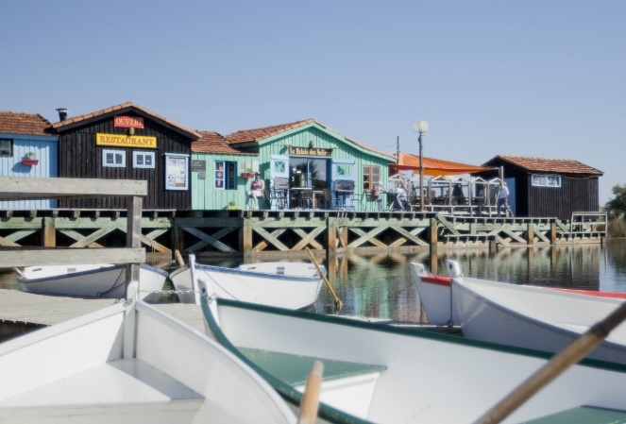
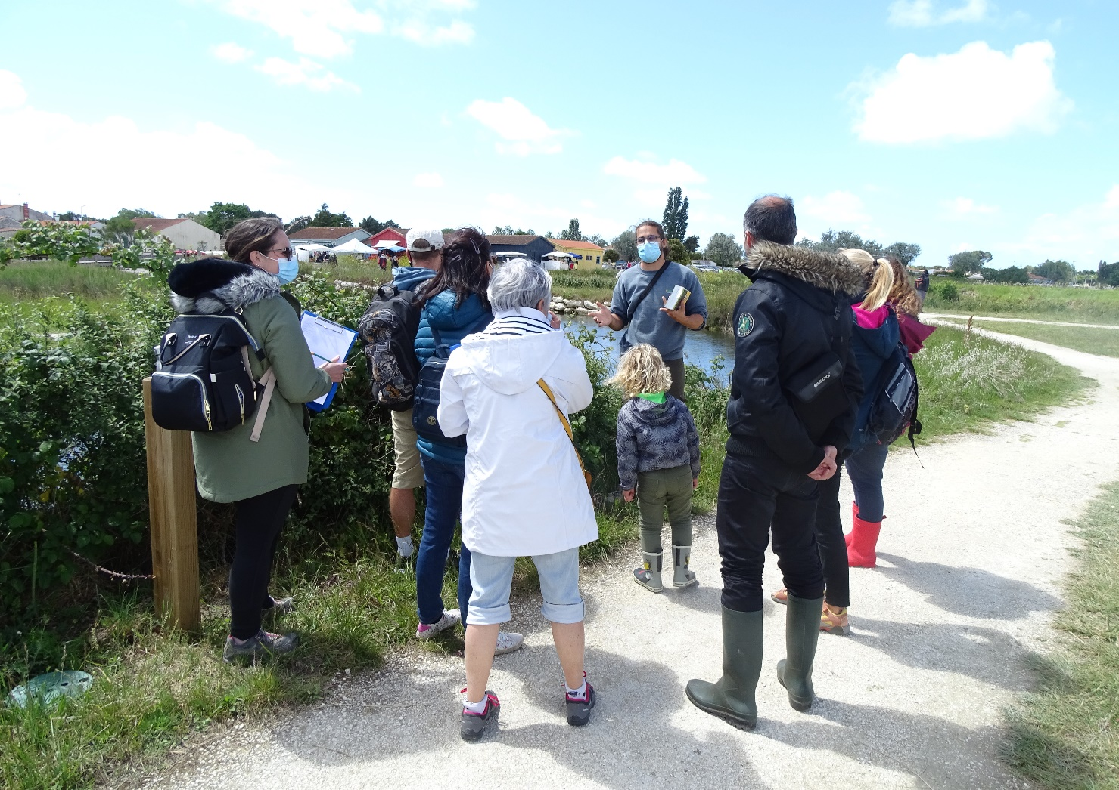
What are your seasonal assets?
We involve local communities in the identification, and enhancement, of their local ecosystem
Marie Duverger is the Site Manager at Port des Salines (FR)
Organise a "Sel à Vie" outing for the residents of the island of Oléron to carry out a participatory inventory of the biodiversity of the site and its salt marshes.
Reach out to passionate individuals and people who wish to be initiated in this kind of knowledge, or who are simply curious to discover their local environment. Anchor our activities in the heart of community life and develop a sense of pride and belonging.
Make it fun via a short-ish format, led by an expert, with a relaxed time of togetherness afterwards to share experiences. Encourage a diverse group, both in terms of interests and age range, to encourage more dynamic exchanges and a more unique experience.
Notes:
©CdC Oléron

Slide 29
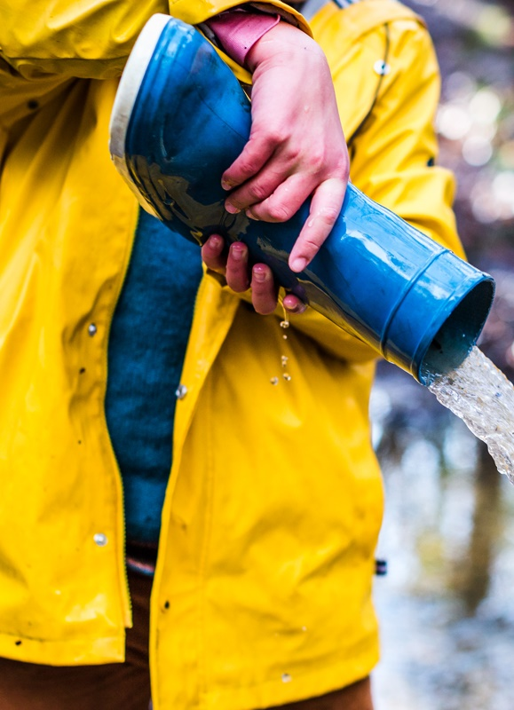
Assess the readiness of what you offer in advance of November to March
Make sure you have the right people, infrastructure and equipment in place
Offer an indoor space. Identify activities that are not weather dependant. If you cannot offer indoor spaces, provide some sheltered places outdoors and use poor weather conditions as a fun/new way to experience things.
Provide suitable equipment. Anticipate your customers' needs by offering weather-proof equipment. Use these to show your customer care and make customers aware of your added service compared to competitors.
Guarantee weather-proof access. Ensure that your place remains accessible under any weather conditions, particularly for customers with limited mobility. Whether it is your parking, driveway or the access between different focal points in your grounds, you need to make sure it is safe for visitors to drive/walk/wheelchair around.
Train your staff accordingly. Build long-lasting relationships with your customers to increase repeat business and loyalty. To do so, make sure your staff knows all there is to know about low season activities, local specialties, traditions and your local environment.
Notes:
©L’oeil de Paco

Slide 30

Assess the readiness of what you offer in advance of November to March
We redesign our experiences specifically to meet our customers’ needs in winter
Andrew Jasper is the Programme Director of RHS Wisley (UK), a vast garden including a glasshouse with three climatic zones
We upgraded our infrastructure, gardening programme, events, visitor flows and marketing to provide an optimal winter experience.
Website showcases the must-see areas of the garden specific to that month, placing emphasis on the plants that are looking their most beautiful. On site, our receptionists and signage emphasise what is in season. This creates a sense of novelty. In winter, we design dusk and darkness activities and events to extend visiting hours. Expend our appeal beyond traditional gardeners to be more inclusive of younger audiences.
Think about your customers’ needs in winter and how to cater for them, rather than expecting the customer to adapt to fit around you.
Notes:
©RHS/Joanna Kossak

Slide 31
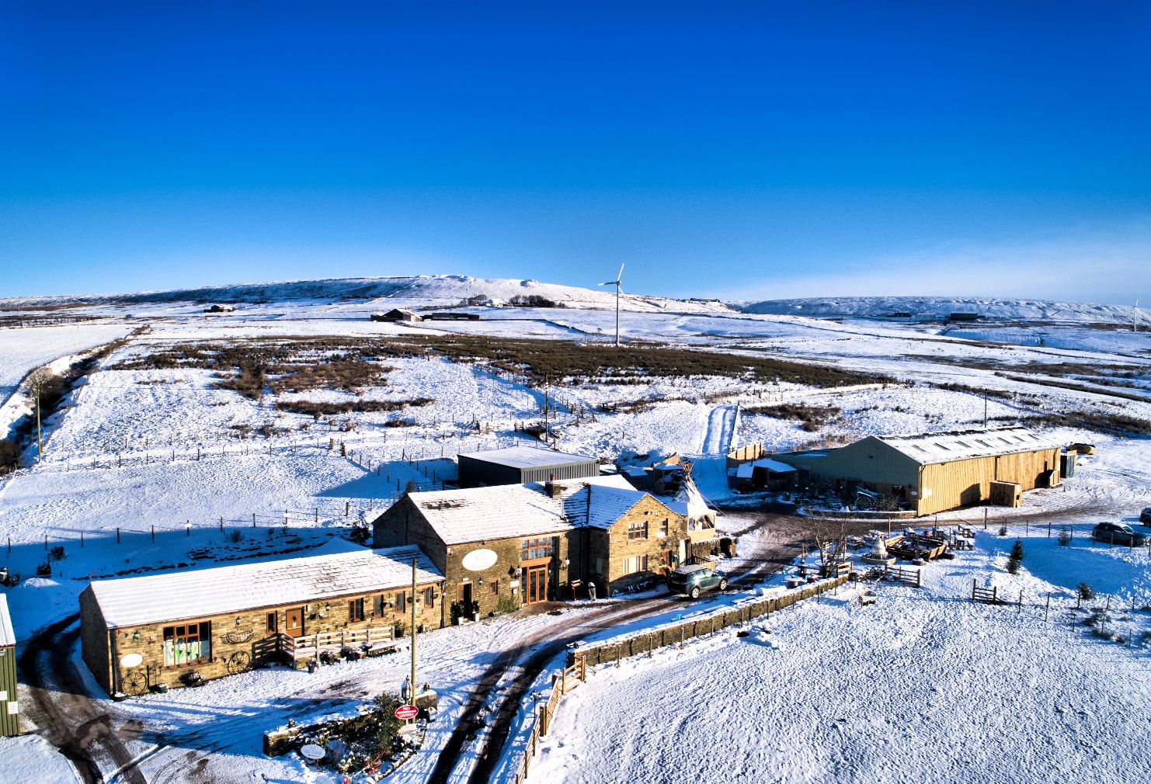
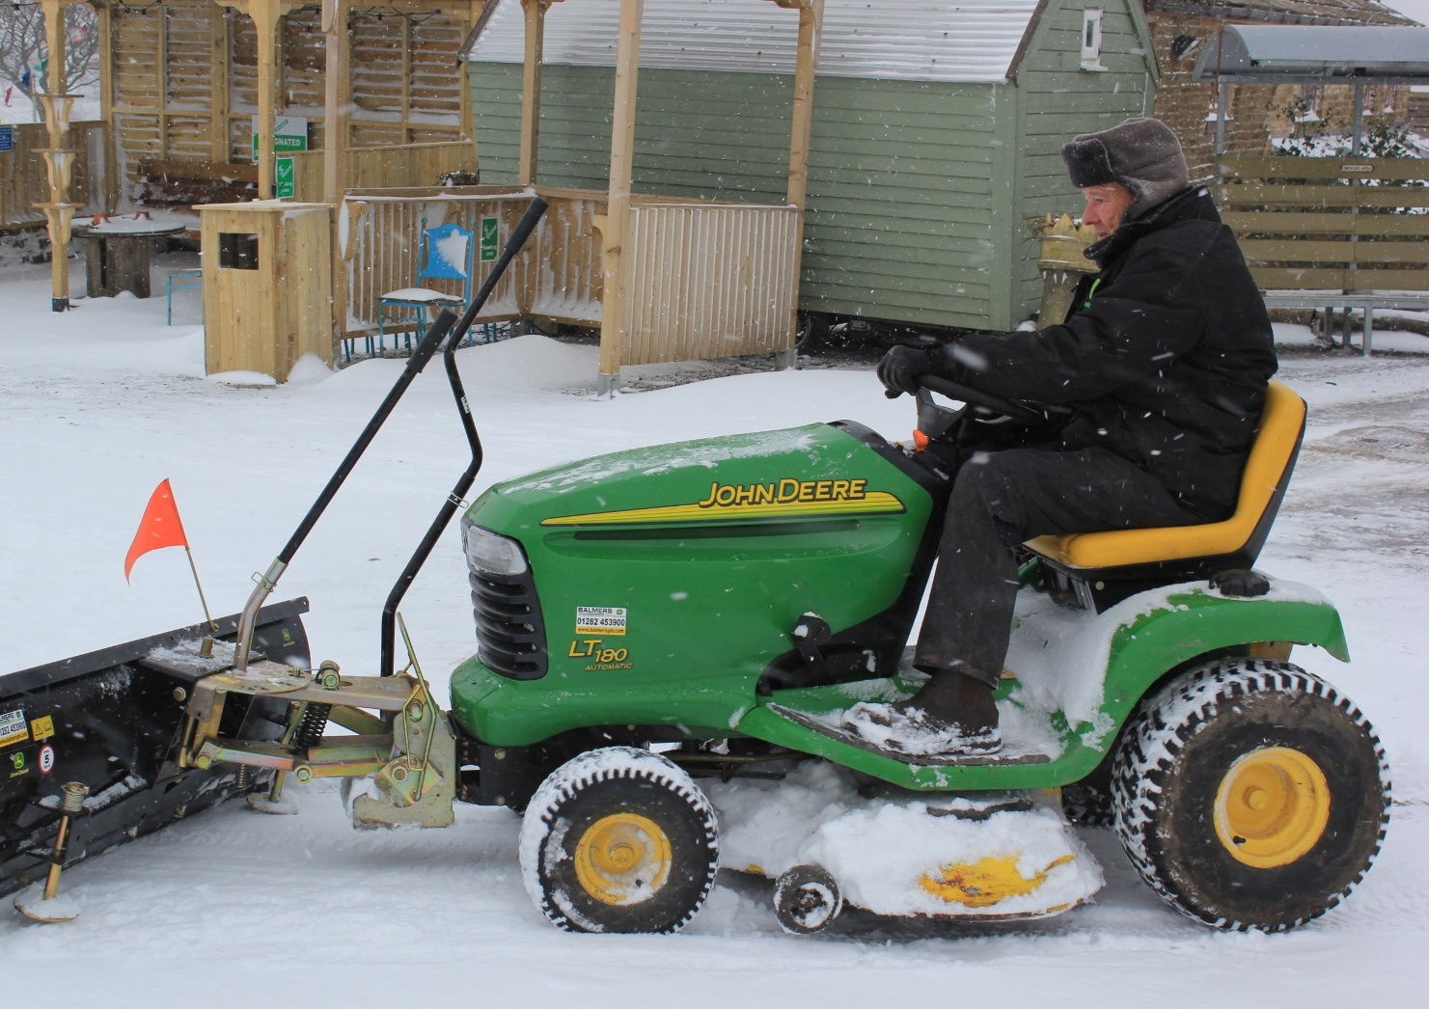
Assess the readiness of what you offer in advance of November to March
We tap into the misconceptions of a winter wedding
Charlotte Hutchesson is the Office Manager at The Wellbeing Farm, a sustainable events venue located in Edgworth (UK)
We create unique, low season wedding packages that change perceptions of winter weddings.
We tackle the fears behind winter wedding by communicating extensive proof of our preparedness to battle poor weather conditions: snow plough and a heavy-duty heater run by power generated from the farm’s wind turbine. Emphasis features that would not be as successful in a standard summer wedding: the theme of Christmas, the longer winter twilight. Show customers endless possibilities of how magically unique the wedding could be.
Never underestimate the power of understanding your customers’ fears. This is a gap in the winter events market that is often overlooked, creating a blue ocean of untapped potential.
Notes:
©Charlotte Hutchesson

Slide 32
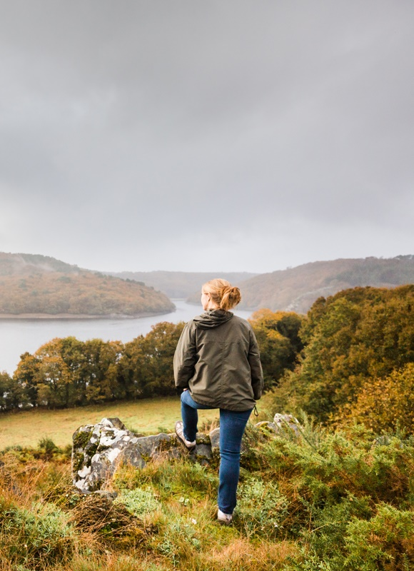
Collaborate with your local network
Anchor your offer amongst the seasonal specialties of your area
Research your local area. Look for activities or traditional production methods that only take place between November and March.
Ex: wild mushroom picking, truffe finding, meat drying.
Identify your local partners. Reach out to local craftsmen, farmers, small producers and people with a unique savoir-faire. Work with them to create unique experiences for your guests and increase the destination’s appeal.
List things to do. Prepare a list of options of activities for your customers. Make it available on your website to encourage longer bookings and in a well-designed folder in your accommodation, so visitors know what to do during their stay.
Inspire your guests. Create an environment for your visitors as an invitation to further explore the unknown gems of your area. With a collection of guidebooks about the seasonal local fauna and flora or novels set at that specific time of the year from local authors. Host a photo/art exhibition from local artists depicting the current season’s scenic beauty or local festivities.
Notes:
©L’oeil de Paco

Slide 33
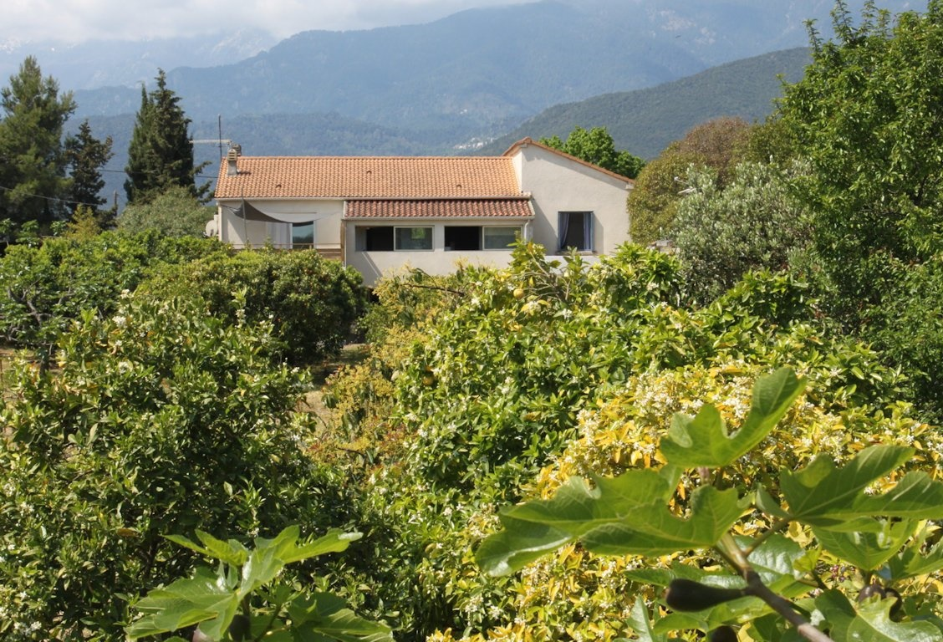
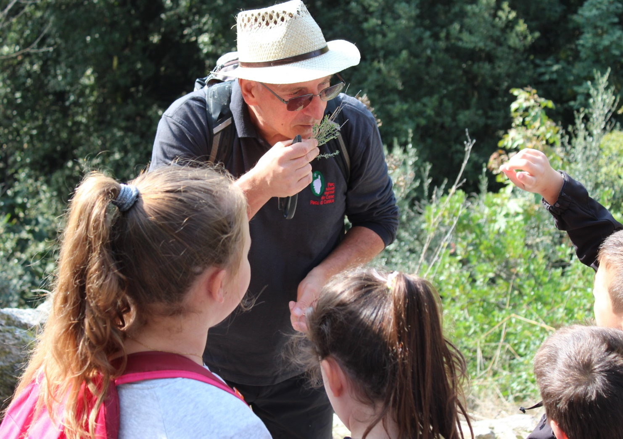
Collaborate with your local network
We highlight our seasonal resources with a solid sense of place
Eliane Grimaldi is the Owner of the holiday cottage A Malba, in Corsica (FR)
We offer our guests a range of unique experiences from an introduction to botany, to behind-the-scenes gastronomic discoveries directly with our local producers such as meat-curing or cheese-making. We encourage our visitors to take part in local preservation projects of the local heritage.
We pass our diverse skills on to our visitors: fine tasting of Corsican honeys, excursions in the forest, discovery of our orchard, visits to local farmers and craftsmen, provision of a botanical explorer's kit for children, sensory games in recycled or upcycled materials in our garden, and much more.
Make your accommodation offering secondary to a full immersion experience in your local heritage. These unique experiences are the real reason to generate a high customer return rate.
Notes:
©Gite a Malba

Slide 34
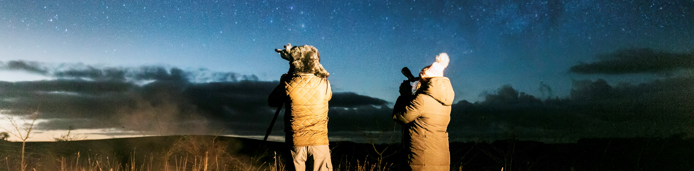
Task 3: Identify low season resources that are valuable to your organisation
The importance of giving meaning to seasonality
Reflect on your personal interpretation. What does autumn and/or winter mean to you? Translate your thoughts into images. What are the mental images you associate with either late autumn or winter?
Research how these materialise in your area. Identify at least three “events” that only take place between November and March in your area, for each of these three categories:
Natural (fauna and flora)
Regional specialties (historical heritage, season-specific savoir-faire, gastronomic specialty)
Cultural (national/regional/local celebrations, community events, arts, sporting events, entertainment)
Turn negatives into positives. Classify your list of winter thoughts and images into positive and negative. For the positive ones, reflect on how you currently use them in your experience design and marketing practices. For the negative ones, think how you can change your services to either turn these into a strength, or how you can overcome pre-conceived ideas that they are actually negative.
Notes:
©Kent Downs AONB and North Downs Way National Trail

Slide 35
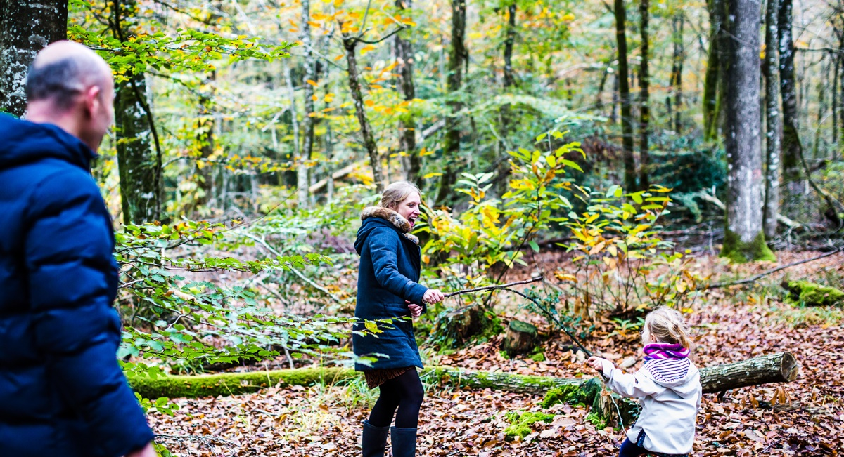
4. Let’s design innovative experiences
Notes:
©L’oeil de Paco

Slide 36
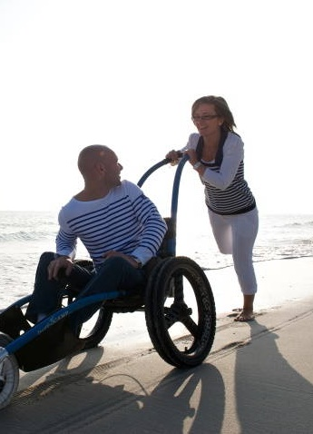
Low season is the time to experiment and learn
Use low demand periods as a chance for product development and market testing
Personalisation. Customers look for products customised to their needs. Personalise low season when you have more time to cater for fewer customers.
Packaging. Identify all the customer needs (transport, activities, food and beverages, entertainment, interpretation, accommodation, souvenirs…) and select the most relevant for your target markets Only package the elements that add value to the customer.
Premiumisation. Emphasise the superior quality and exclusivity of your experiences to make your customers feel special. This also allows you to be less price sensitive.
Gamification. Engage your customers with playful experiences to encourage them to spend more and come back.
Co-creation. Customers want to be the protagonists of their experiences not spectators. Find a way to involve them further and create opportunities for them to share their experiences with others on-site and online.
Notes:
©Diaphaneell Prod

Slide 37
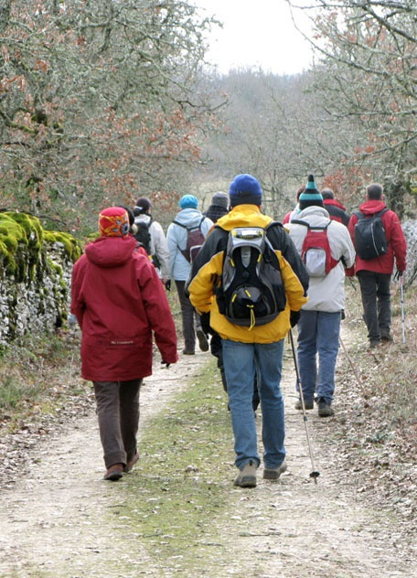
Low season is the time to experiment and learn
We offer a different experience in the low season
Elsa Déléris is the Owner of the holiday cottage gite de Poudally (FR)
We designed a “werewolf trail” experience to group and family customers that consists of a moonlit hike with a gastronomic stopover in a traditional “caselle” (local stone shepherd’s hut).
We packaged an experience to fit the expectations of our winter target markets (hikers and family groups), mixing up the elements of an accessible hike, local gastronomic delights, a departure time that suits young families and an overall experience no longer than 3 hours with both exciting and relaxed times.
Use the low season to revisit classic routes by offering a different perspective. Make sure you craft your experience towards your winter target market.
Notes:
©Gite de Poudally

Slide 38
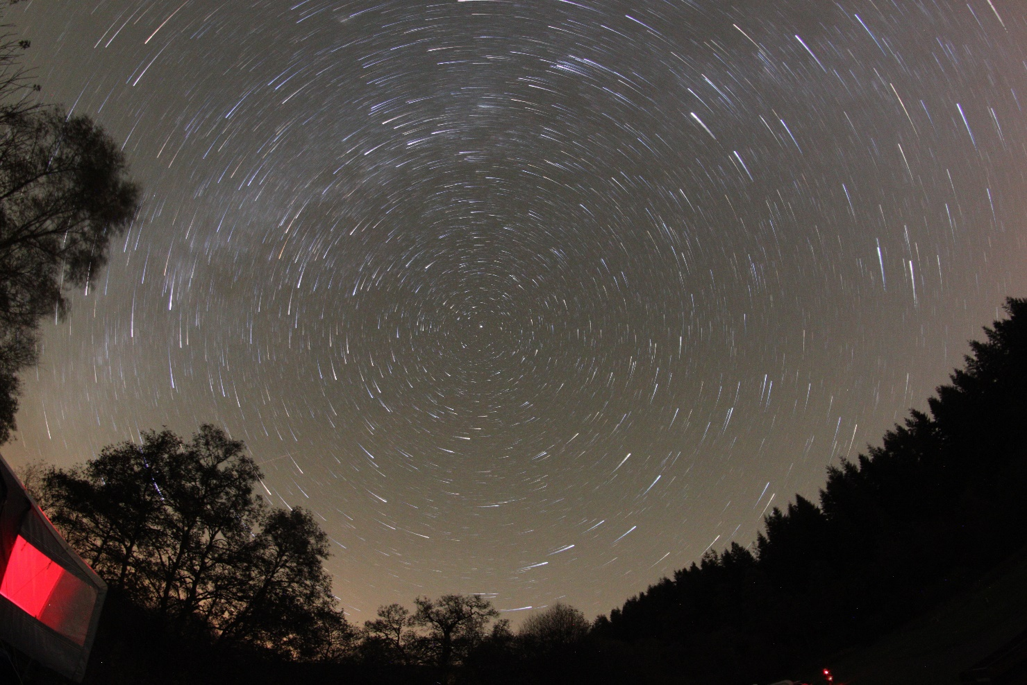
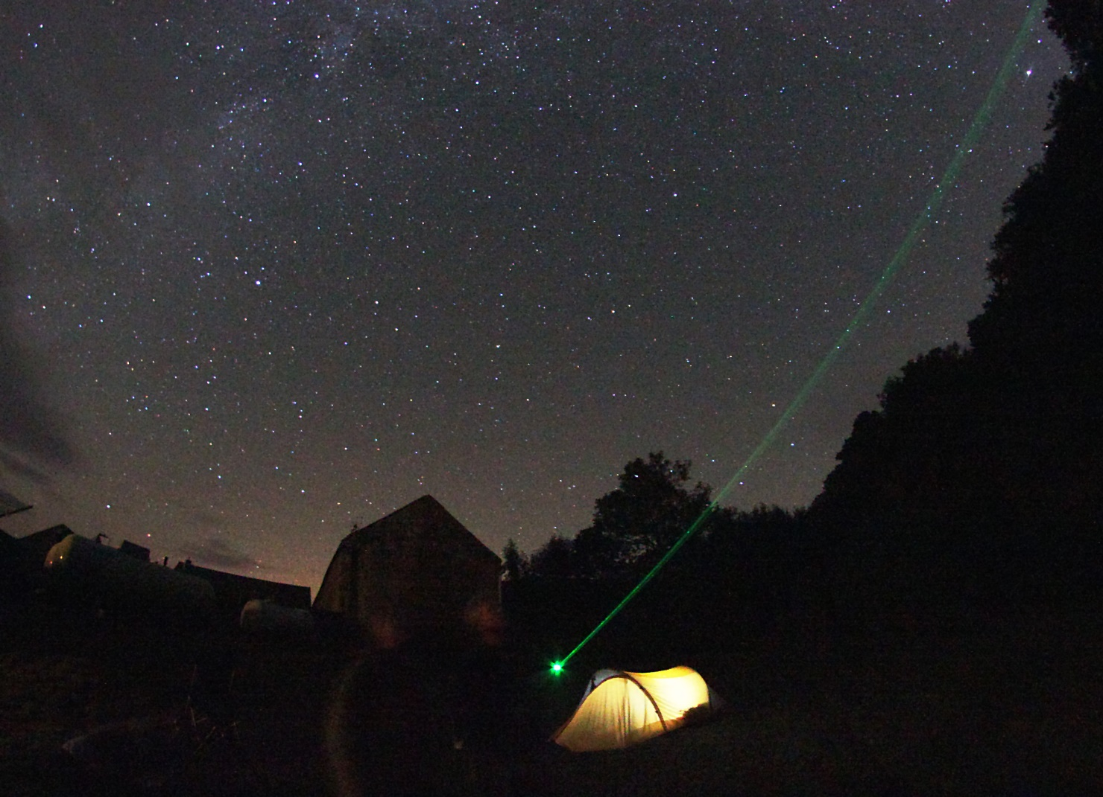
Low season is the time to experiment and learn
We raise awareness of our resources amongst businesses
Hetty Byrne is the Sustainable Tourism Officer at the Forest of Bowland AONB (UK)
We promote winter as the best time of year to star gaze, when you can see the Milky Way on moonless nights with the naked eye.
We identify five designated Dark Sky Discovery Sites and engage with about 20 tourism businesses as 'Dark Sky Friendly', which means that they proactively plan to reduce light pollution. The AONB runs a Dark Skies Festival week (in February half term) and encourages visitors to stay in the Dark Sky Friendly accommodation.
For situations in which you need a critical mass of activity to create a new product, you need to work in parallel with local supply to raise awareness of the potential available. Launching a new experience in the market requires capturing the attention and imagination of both businesses and customers.
Notes:
©Robert Ince

Slide 39
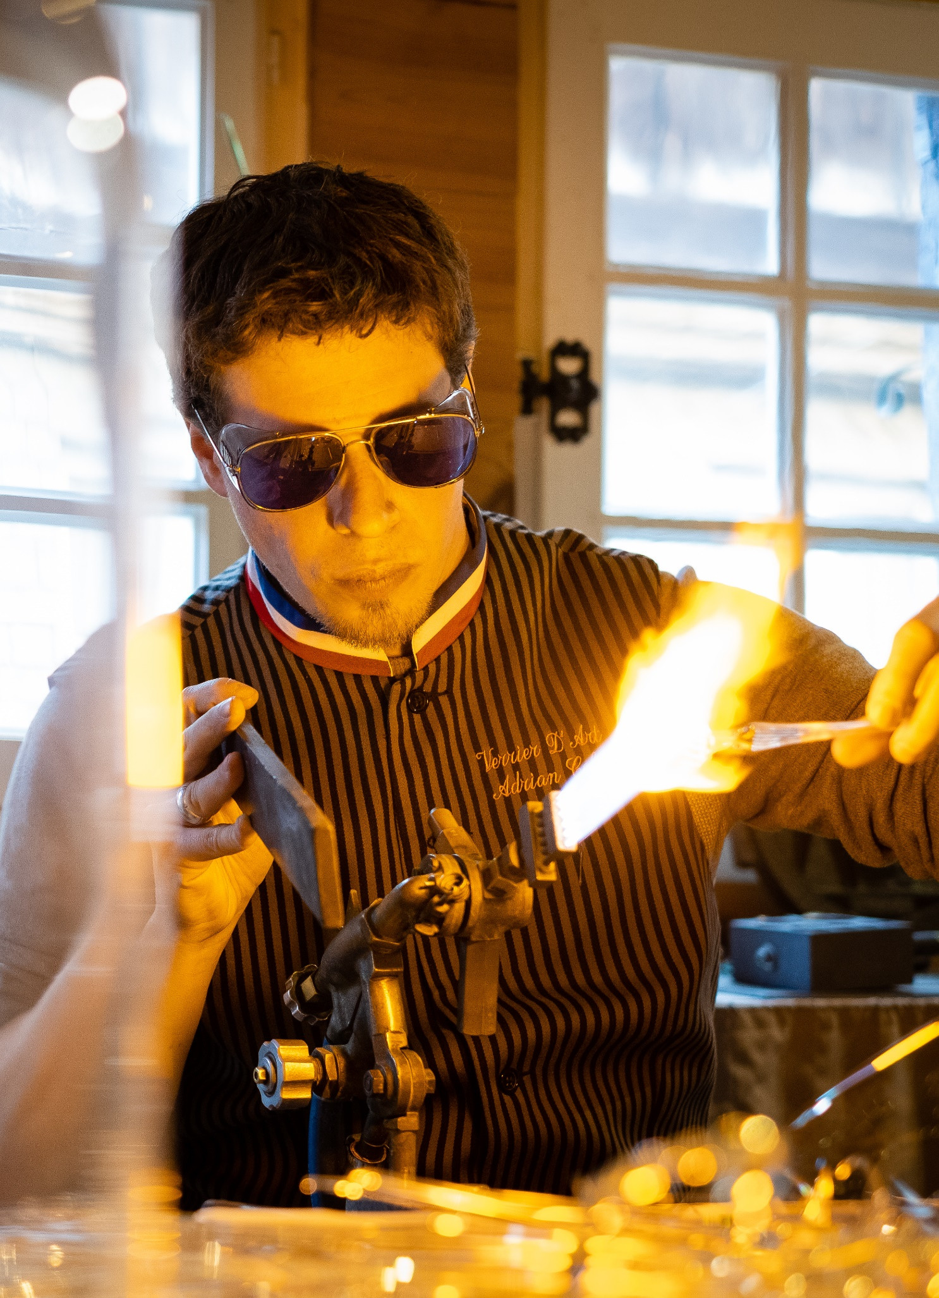
Create economies of scale and new experiences
Bring in your partners and competitors to maximise your impact and reduce risks
Find a common need with other businesses in your area. For example, the Christmas season is not exploited to its full potential. If you are a venue or a hotel, your impact on your own is limited despite your best efforts to be creative in your offer. Yet, if different local organisations was to put on an attractive show, the range and scale of your appeal to potential visitors has the potential to be much more effective, with everyone benefitting.
Coordinate exchanges between stakeholders (or find the right facilitator to do so) to find a common approach and put together a finely tuned communication campaign that offers a range of complementary local experiences to your visitors.
Share data. Data that might be irrelevant to some may be relevant for others. The more information that you, and other local stakeholders, can gather on consumer behaviours and expectations, the more easily you can form a cohesive and impactful communication campaign and design better experiences for your visitors.
Join forces. Create new experiences by combining complementary products and services, and share the marketing effort and risk.
Notes:
©PEREZ Rafa

Slide 40

Create economies of scale and new experiences
We find synergy with local stakeholders that share the same issues
Claire Ballossier is the Communications Officer at the departmental tourism development agency Loire-Atlantique Développement (FR)
We have created a platform to promote our coastal destination, bringing together five seaside resorts by initiating "La Mer en Hiver" campaign.
We group offers under four key categories: Thrills (outdoor sports), Wellbeing, Nature, and Family. Our communication style is based on a vocabulary drawn from the mountains and winter games (slopes, wetsuits, sliding, slalom, etc.) to give a playful tone to change habits.
Multi-sector collaboration is key to the success of an ambitious communication campaign. Play on the fun aspect to encourage a new look and a better commitment from consumers.
Notes:
©Loire Atlantique Developpement

Slide 41
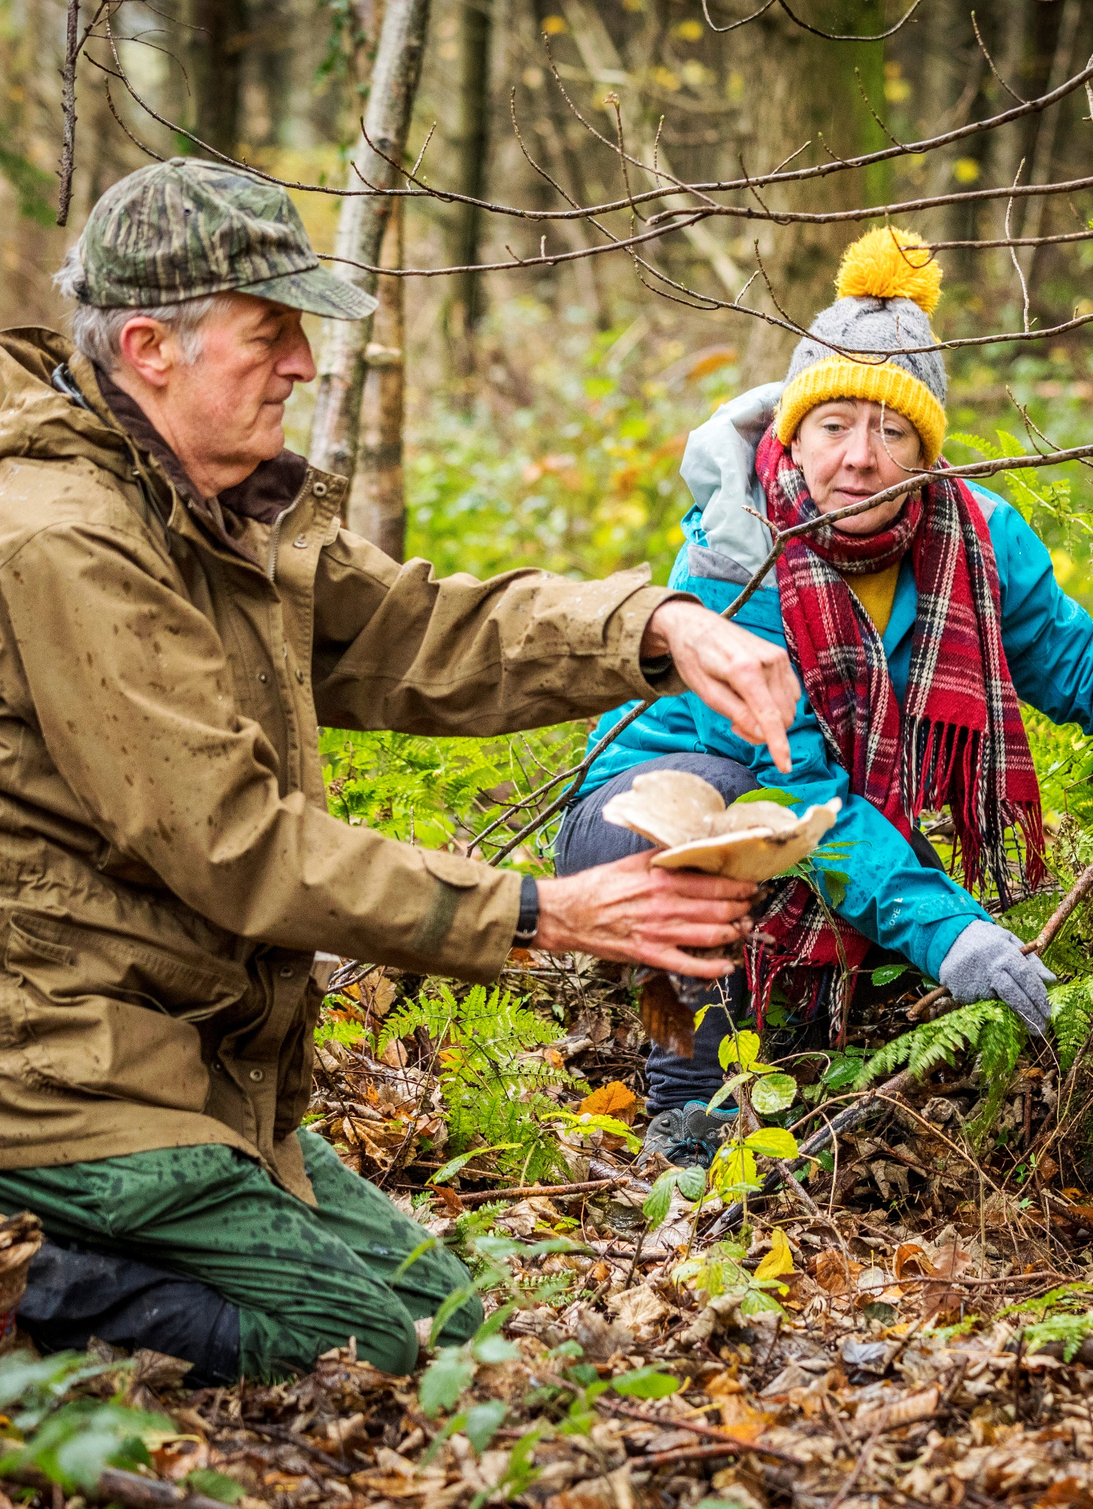
Tap into people’s yearning for a meaningful experience
Tailor experiences around wellness, self-discovery and purpose
The bucket list. Out-of-the-ordinary experiences, “extreme” and/or weird and wonderful experiences.
Reconnecting with nature. Strong desire for some urbanites to reconnect with nature. Further enhanced by the COVID-19 pandemic.
Going back to simpler things. Offer no internet zones/sites, replace the microwave with a fire pit, provide hampers with fresh local produce and a cooking guide rather than ready meals.
Learning traditional savoir-faire. Offer the possibility of learning long-forgotten crafts to give people a sense of belonging. Ex: Spin wool, identify wild plants.
Exploring oneself. Through wellness, meditation, sport or experiences that will bring people out of their comfort zone. Turn it into a personal journey of self-discovery.
Notes:
©Kent Downs AONB and North Downs Way National Trail

Slide 42
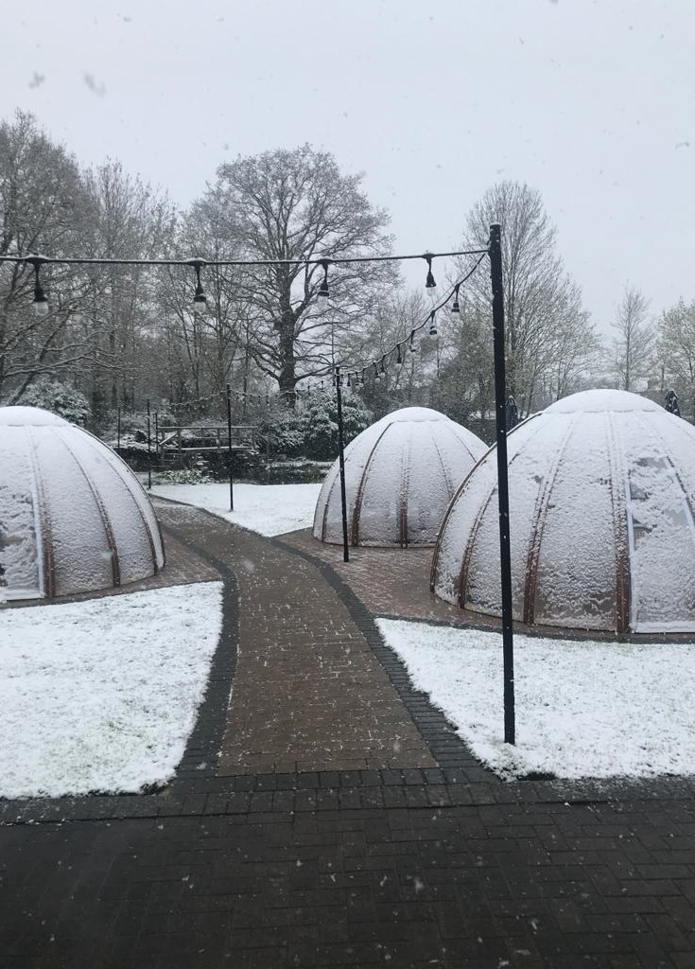
Tap into people’s yearning for a meaningful experience
We optimise outdoor spaces during the colder months
Dawn Singh is the Duty Manager of Stirrups Hotel (UK)
We offer four luxury pods as an sheltered outdoor dining experience that increases low season capacity and provides a night under the stars, no matter the weather.
To optimise demand, the pods are booked for £40 within five slots: Breakfast, Lunch, Afternoon Tea, Dinner and Drinks. Use of small fan heaters and additional blankets and cushions.
Personalise the pods with lights, candles and a small speaker. Add a buzzer for guests to press when they need service.
Notes:
©Stirrups hotel

Slide 43

Translate emotions into experiences
Certain emotional states are associated with seasons: translate those expectations into live experiences
Cosiness/Hygge. When it’s wet, cold and dark, compensate with warm and light inside.
Timelessness. Approach time differently by offering experiences in which time is not of the essence. Promote activities that allow your customers to learn a new skill. Ex: painting, drawing, cooking, crafting.
People. The unexpected laughs, the deep conversations, the shared experiences. Enable those connections by offering the suitable space and time for it. Market holidays as time for yourself and your loved ones.
Adventure. Time for exploration, pushing the limits and going out of the comfort zone.
Notes:
©Norfolk County Council

Slide 44

Translate emotions into experiences
We offer an opportunity for togetherness and a romantic all-year round experience
Robert Rezin is the General Manager of Brentwood Hotel (US)
We set-up fire pits in our rooms which create a lovely romantic atmosphere all year round, but especially in colder seasons.
We offer 5-dollar packs that contain chocolate, marshmallows and crackers, the trinity required for making the American campfire classic of s'mores. Simple treat that adds disproportionate romance to the firepit experience and enhances the word-of mouth demand.
Find a way to meet the growing demand among guests for experiences of togetherness.
Notes:
©Robert Rezin

Slide 45

Get a calendar
Identify unique opportunities every month of the year and celebrate them
Halloween. The market for higher end tailormade experiences is growing fast.
The market for pre-Christmas office parties. A sustainability/authenticity themed team building experience gives that otherwise “samey” annual party a new sense of adventure.
Christmas shopping. From participation in workshops where you make your own personalised gifts to purchasing luxury, expertly made crafts, gifting experiences.
Christmas and New Year holiday. Offer themed Christmases - family ones focused on Santa's elves, or adult ones focused on a particular theme of music - jazz Christmas, folkloric Christmas.
Between New Year and Valentine’s Day. Promote your experience as a Christmas gift for family members to buy each other and you are likely to get these vouchers cashed in during January and February.
Snowdrop walks. Incentivise January and February visits to your destination by creating and promoting snowdrop walks, in the same way that you can create bluebell walks in May.
Chinese New Year. Excellent opportunity to celebrate Chinese culture and to generate sales.
Lambing season. Promote an Instagram campaign to photograph early lambs at your destination from March.
Notes:
©Kent Downs AONB and North Downs Way National Trail

Slide 46


Get a calendar
We create award winning events for a growing niche market
Stuart Beare, an unconventional farmer, transformed the family run Tulleys farm (UK)
We developed the “Shocktober Fest” Halloween festival, which now holds the prestige title of the “UK’s No.1 Halloween Attraction”.
The use of special effects, impressive scenery and live actors creates an immersive atmosphere and unforgettable experience year after year. We offer ten haunted attractions, live music and freshly prepared food. The festival now attracts over 100,000 local and national visitors of all ages employing hundreds of local events staff, actors and musicians.
Create a seasonal experience that complements your current event calendar to increase visitation at less busy times in the calendar year
Notes:
©Tulleys farm

Slide 47

Create your own events
Rely on creating unique events to generate demand in low season
Creating your own event can be a fantastic way to bring together your local community, highlight your organisation’s values, strengthen your brand identity and increase your visibility.
Find below a non-exhaustive list of event types:
Art festivals (music, cinema, theatre, culture)
Exhibitions and shows (hosting community groups and local dance or music schools)
Food (street food events, buying locally sourced and delicatessen produce, learning how to cook)
Shopping (pre-Christmas markets, artists’ open homes, make your own gift events)
Societal events (historical event, local celebrity, political movements)
Entertainment (festival of light, carnival, Halloween, shows)
Trade events
Unusual/exclusive/one-off events
Notes:
©L’oeil de Paco

Slide 48

Create your own events
We create original events to attract visitors in off-peak periods
Sylvain Piantanida is the Site Manager at Les Jardins Sothys (FR)
We use the low season to design and offer some of our most creative events.
Annual calendar of events: bird photography workshops, nature conservation workshops led by an expert for young audiences, itinerant theatre piece
Offer new experiences every year to keep on appealing to them. Adding extra services such as a restaurant can play an important role in retaining a local audience.
Notes:
©Les Jardins SOTHYS

Slide 49

Task 4: It’s cold, wet and dark: what shall we do?
Work with the seasons, not against them
List your three top selling products or services in winter.
Now write down what makes them different to your summer products.
Are the differences positive, such that you want to enhance them, or are your best winter products a poor version of your summer product? It may be better to increase your offering, i.e., provide additional benefits to consumers, rather than simply reduce prices.
It’s time to brainstorm ways to enhance your products to become appealing winter experiences:
Theme it: decorate for Halloween, Christmas and then Chinese New Year, so your customers always find something new.
Make it longer: mix indoors and outdoors by adding extra activities such as an Autumn leaves family hunt and collage.
Make it unique: tempt customers with small gifts such as a small drink or food tasting.
Make it special: promote beach walks with your dog, which are not possible in peak season.
Increase the size of the group: incentivise past customers to bring a friend.
Share it with another business: Bring in an expert on a certain topic who needs a venue (or offer your expertise to different venues).
Share it with the community: have an open day for schools, care homes, community groups.
Other ideas?
Notes:
©Kent Downs AONB and North Downs Way National Trail

Slide 50

5. Time for marketing and storytelling
Notes:
©L’oeil de Paco

Slide 51

Invest in low season marketing resources
You will need to work harder to attract winter, rather than summer, customers but the efforts will pay off all year round.
Identify communication channels. Search online for “ten things to do in winter in my area”, or “winter wedding venues”, or “winter days out”. Understand what those suppliers of experiences do that is different to your offering, and figure out how you can pitch for your business to be included.
Identify online publications in need of content. Travel blogs and magasines need content so if you have a unique experience, invite journalists to experience your services and pitch a story to them.
Enjoy winter photography. Customers want to be able to picture themselves in the photography you use in your marketing efforts. Winter photography of cosy interiors and fireplaces, and beautiful landscape winter scenery can be compellingly evocative and inviting.
Update your website regularly. Your website today needs to show what your business, and its surroundings, look like at the time that your customers expect to visit you. Prepare website content that is season specific and rotate it throughout the year.
Market onsite to encourage repeat custom. Through a leaflet, a coffee table photo book, or photos on your walls.
Notes:
©L’oeil de Paco

Slide 52


Invest in low season marketing resources
We widen our appeal by harnessing social media trends to attract a new audience
Elizabeth Meath Baker is the Director of Walsingham Estate Trading Ltd, responsible for public access to Walsingham Abbey, Norfolk (UK)
Instagram allows us to introduce our snowdrop walks to a new audience who are seeking instagrammable settings in which to take pictures, for example, of their children, partners or dogs.
We are developing a collection to showcase the snowdrop’s amazing range, and we have designed the Abbey’s gardens to provide snowdrop photo opportunities. Snowdrops work well to attract social media attention and increase demand for days out, at a time of year when there are few leisure opportunities.
Design your visitor experience to encourage people to spend more time, and money, by providing them with a number of “must do” activities. Encourage them to share photos of their experience.
Notes:
©Walsingham Estate

Slide 53

Harness the power of social media
Create a social media plan and follow it systematically
Set yourself a target. Figure out what you want to achieve and why it matters to you.
Learn about your customers. Use social media analytics to learn more about the profile of your followers, so you can meet their needs.
Learn from your competitors. Identify 3-5 businesses similar to yours that are more successful in social media and learn what they do differently.
Learn what already works for you. What’s different about the social media post that had the highest number of likes or shares, compared to your “average” post? Is it the time of day, the fact it has a better photo, the language you use, or that the content was funny rather than factual?
Each social media channel has a purpose. While Facebook and Instagram outrank all other channels in communication with customers, the purposes of YouTube or TikTok are very different.
Create a social media content calendar. Set up a posting schedule, for example with Hootsuite, so your posts are spaced out and they are released at the time of maximum engagement for your audience.
Set up social media competitions. Provide incentives to your customers to post about you.
Get professional help. While micro influencers with few followers may be happy to provide reviews for free in exchange for free use of your facilities, the people that are more established in social media will require a payment.
Notes:
©Craig Pedley

Slide 54

Harness the power of social media
We have a winter-themed Social Media Marketing campaign
Boutique Retreats is a holiday letting agency with a wide-ranging portfolio of 150 unique properties of various styles (UK)
We encourage low season bookings with special offers and the main way we promote these is through social media.
Social Media Marketing = Photography + Affiliate Marketing
The Power of Photography: Pictures of cosy interiors and log fires on Instagram enhance peoples’ desire to visit
Affiliate Marketing: We investi in our affiliate program, partnering with influencers and brands. We track the benefits with links, product/account tags, exposure, exchange of followers.
Strengthen audience engagement on social media through eye-catching photographs and collaborations with influencers.
Notes:
©Boutique Retreats

Slide 55

Become a storyteller
Connect and inspire so that your prospective customer feels something
Sensory experience: engage your audience with visual content such as pictures and videos. Vision accounts for more than 50% of purchase intention. Sounds, smells, taste, touch can also improve advertisement effectiveness.
Emotional experience: create emotion-inducing stimuli such as happiness (more shares), sadness (more clicks), fear/surprise (more loyalty), anger/disgust (viral content).
Problem-solving experience: engage your audience with creative thinking and make them curious about your offers.
Physical/virtual experience and lifestyles: focus on the virtual experience of interaction with both products and other individuals, since action-oriented advertisement communicates motivation and meaning.
Ideal self: embellish customers’ appeals for self-improvement and their desired impressions of the social context, for example, through social media and influencers.
Notes:
©L’oeil de Paco

Slide 56


Become a storyteller
We bring autumn to life with colour-blind-friendly scenic viewers
Commissioner Mark Ezell heads the Tennessee Department of Tourist Development (US)
We have installed “colour-blind” (colour vision deficiency) viewfinders powered by EnChroma lens technology at 12 parks and scenic overlooks across the Tennessee State.
Using EnChroma technology, Tennessee installed 12 new viewfinders at scenic overlooks across the state. The ground-breaking spectral lens technology is designed to enable people with colour vision deficiencies to see a broader range of clear, vibrant colours. Our video content showcase the incredible experience for colour-blind tourists, and serve as an unprecedented marketing campaign for the stunning beauty of Tennessee during autumn seasons.
Be on the lookout for innovative technologies of the 21st century that can open up the experiences of your destination to people with disabilities.
Notes:
© TNVacation

Slide 57

Involve your customers in your storytelling
No one says it better than the people who have experienced it for themselves
Customers trust other customers more than they trust you.
Create discussions, not just adverts. Promote local activities or events, seasonal events, local charities.
Provide dedicated platform such as:
A live Instagram feed with a hashtag of your creation.
A blog with guest contributions.
A participative digital campaign.
A contest for the funniest videos, the most unusual pictures or the most beautiful images of your site/venue/area.
Encourage and reward your customers to create user-generated content about their experiences at your property or destination.
Notes:
©L’oeil de Paco

Slide 58


Involve your customers in your storytelling
We co-create activities and social media campaigns
Martin Reynolds and Alice He are responsible for the China Ready Initiative at Edinburgh Tourism Action Group (UK)
We collaborate with around 30 visitor economy businesses in Edinburgh to develop Chinese New Year experiences.
We provide a toolkit of resources for businesses in the visitor economy including a website, online briefing documents and webinars. We encourage organisations to light up their buildings in red, to decorate their shop windows, to give red envelopes to customers and, generally, to learn how to welcome Chinese visitors.
Develop opportunities for user-generated content on social media that is authentic and driven by your target audience.
Notes:
©Martin P. McAdam
©Neil Hannah

Slide 59

Task 5: Adapt your marketing effort to the different value you gain from different customers
Use your time and resources smartly
Let’s assume you can break down your database in the following way:
Group 1. Most valued customers. If you are a cafe or restaurant, they may come weekly. As an accommodation business, they may come two or three times per year.
Group 2. Regular customers.
Group 3. Occasional customers.
Group 4. Once in a lifetime customers.
Group 5. Enquiries that did not convert into customers.
With every group you want them to move up to the higher group, e.g., for those in Group 5, you would like them to buy for the first time (becoming a Group 4 customer) and you may need to offer them a discount to do so. With Group 4 customers, your aim is to get them to visit again (becoming a Group 3 customer) so you will need to tell them that your experience has improved or that there is more to do. And so on.
Your task is to identify which sustainable experiences you are willing to offer to each group to tempt them to book with you next time, based on the principle that the more valuable the group, the more you should be willing to spend to keep them.
Notes:
©ARC

Slide 60

6. Be clear what benefits you expect
Notes:
©L’oeil de Paco

Slide 61

Reducing seasonality has a wealth of benefits
There are many reasons to innovate
Generate a year-round income. Create unique products and diversify your markets to provide continuity to your business.
Improve the quality of your service. Create year-round jobs to give your business the opportunity to retain talented staff and to reduce your recruitment and training costs.
Maintain your mid-season prices. Increase the quality, variety and attractiveness of your offer so that you don’t need to reduce your prices.
Provide a consistent service. Open all year round to allow your business to set service standards and professionalise its service.
Be more creative. Open in the low season to give yourself the chance to experiment with changes in your products that you might find too risky or time consuming in high season.
Increase loyalty. Open all year round to gain more repeat customers as they favour businesses that are reliably open.
Notes:
©L’oeil de Paco

Slide 62

Reducing seasonality has a wealth of benefits
We open year-round to secure staff jobs and guarantee the quality of service
Philippe De Bellevue is the Commercial Director of Les Ormes Domaine and Resort (FR)
We have worked particularly hard on our winter capacity by creating low season activities.
We developed infrastructures such as a golf course, an equestrian centre, a water complex, and quirky accommodation such as water huts, tree houses and “cottage huts”, meeting spaces…
Hiring seasonal workers can pose significant challenges in terms of quality, continuity and integration/training. Switching to be an annual operator, combined with training and investing in teams, can allow you to maintain the highest level of service quality and customer satisfaction.
Notes:
©Domaine des Ormes

Slide 63


Reducing seasonality has a wealth of benefits
We create gift vouchers to generate low season demand
Isabel Sanchez is the Site Manager at the “spa cabins in the trees” Pella Roca (FR)
We have created a unique site of unusual accommodation: spa cabins in the trees overlooking nine hectares of truffle fields, moorland and forest.
More than 25% of our bookings come from gift vouchers that we sell directly on our website.
Create a sense of uniqueness for these gift vouchers. Offer the possibility to personalise each voucher, be it with additional a la carte services, personalisation of the message or the choice of the basic package.
Notes:
©bestjober
©Mathile Chassin

Slide 64

Task 6: Make space to think creatively
It’s time for you to prioritise what you will take away from this manual, and use it in your organisation
Consider the list of objectives below and rank the items from most to least important:
Year-round income
Better quality of your service
Reliably high mid-season prices
Consistent service
More creative
Better customer loyalty
Reflect on your work practices. Write down the last innovative things you have done, identify which of the six objectives above these innovations contributed towards, and how successful they were.
Now identify one example from the previous case studies that you can adapt to your business to achieve the benefits that matter the most to you. Aim to replicate the easiest example, that requires the least amount of effort. Only once you’ve succeeded, move to the second easiest, and so on.
Make a list of tasks that you need to do, in order to replicate that example. Write down how long you think each task will take, and whether they are recurring or one off-tasks.
Schedule time in your calendar for these tasks, at times that you can clearly protect to do them. Make this a realistic plan to minimise the chances of deviate from it. If you fail to do something once, get back on track and never miss twice.
Share your plan with someone else, and it’s important that make a commitment to that person that you will stick to your plan, and that they hold you accountable to it. Check in with your “innovation buddy” weekly or monthly, to share your progress.
Notes:
©L’oeil de Paco

